Slide 1

TaiRox Productivity Tools
Don Thomson, TaiRox CEO

Slide 2
Agenda
TaiRox Website Resources
Productivity Tools Overview
What is Productivity Tools Enterprise?
The Most Compelling Productivity Tools
The Latest Productivity Tools

Slide 3
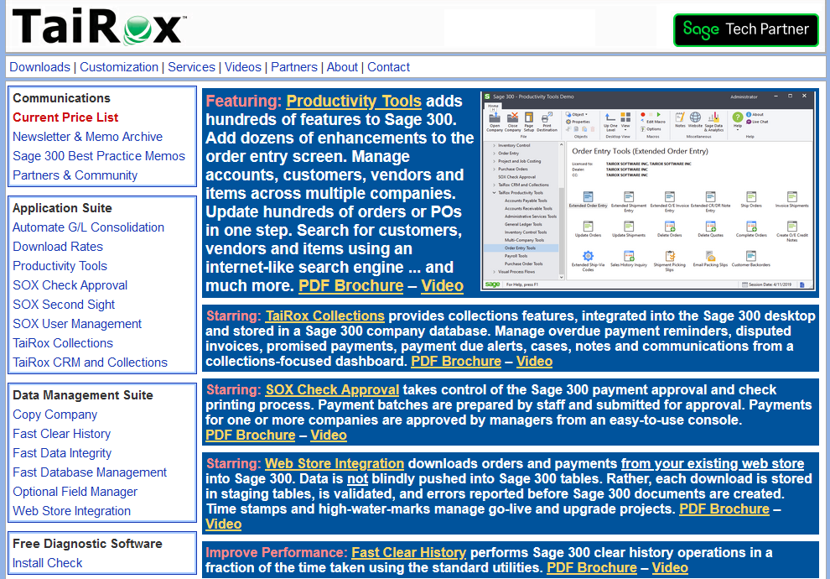
TaiRox Website
Up-to-Date
  Price List
  PDF Brochures
  Videos
  Memos
  Newsletters
  Downloads
  Release Notes
  Install Check

Slide 4
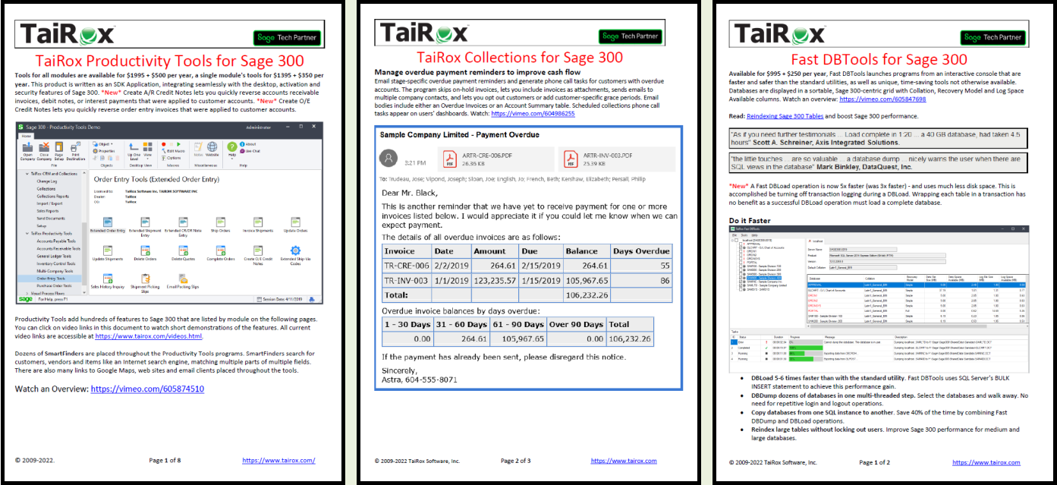
PDF Brochures with Embedded Videos

Slide 5
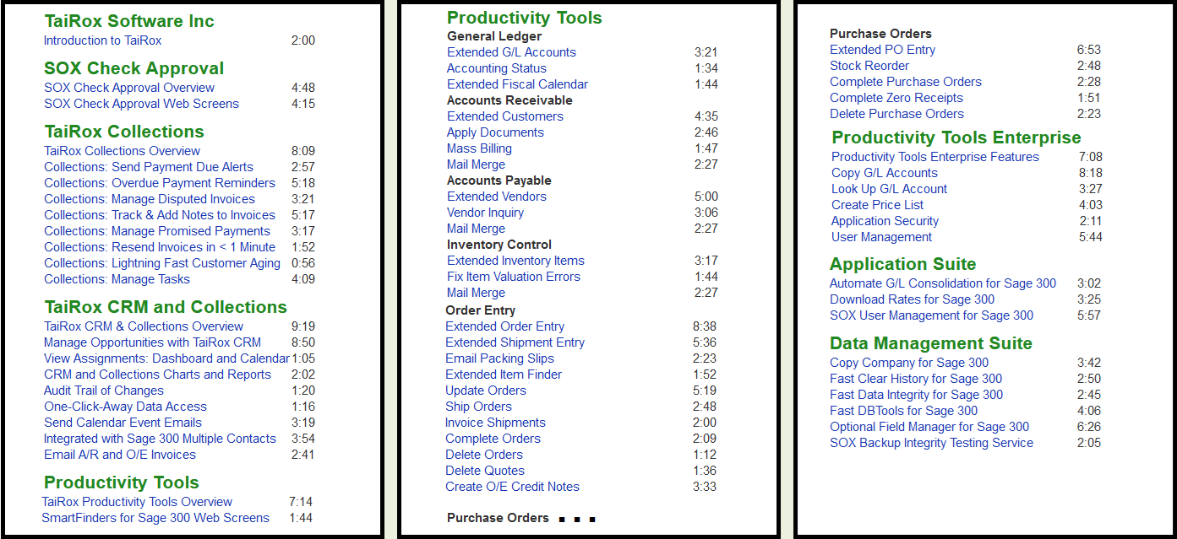
Videos Page

Slide 6
Memos: Sage 300 Technical Details

Slide 7
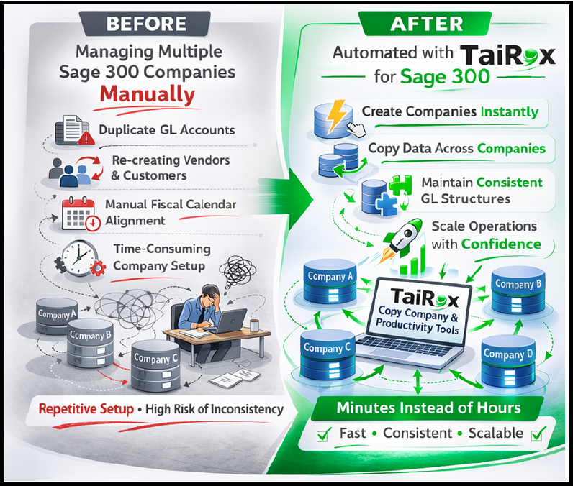
Productivity Tools Sweet Spot #1
Clients with multiple Sage 300 companies
  Using the same or similar accounts, customers, vendors or items

Slide 8
Productivity Tools Sweet Spot #2
Clients that use Inventory, Order Entry or Purchase Orders
  Lots of orders or purchase orders
  Orders or purchase orders with 100+ detail lines
  Clients with thousands of inventory items
    SmartFinders find items faster
  Orders with strict requirements
    Must have a purchase order
    Must meet minimum margin requirements (e.g. food distributors)

Slide 9
What Is Productivity Tools? 50+ Programs
Extended
  The program “takes over” a Sage 300 UI
Complete, Delete, Update, Ship, Invoice, Apply, etc.
  The program performs hundreds of operations
Inquiry, Status, Look Up
  The program provides improved visibility into data

Slide 10
What Is Productivity Tools Enterprise?
Copy G/L Accounts
  Manage a multi-company general ledger
Lookup G/L Accounts
  When there are 50,000 accounts using 10 segments
Tag Posted G/L Transactions
  A simpler way to cost jobs
User Management
Application Security
Create Price List Spreadsheet
Remove Items from Price Lists

Slide 11
Nice To Have for Many Clients
SmartFinders
Vendor Inquiry
Sales History Inquiry
Accounting Status
Apply Documents
Delete Orders
Delete Purchase Orders

Slide 12
Compelling Benefits for Many Clients
I/C SmartFinder
O/E Extended Order Entry
O/E Update Orders
O/E Ship Orders
P/O Extended PO Entry
P/O Extended PO Receipt Entry

Slide 13
Compelling Benefits for Some Clients
One Example
  Extended Fiscal Calendar
  Extended Create New Year
All Productivity Tools programs were compelling to at least one client.

Slide 14
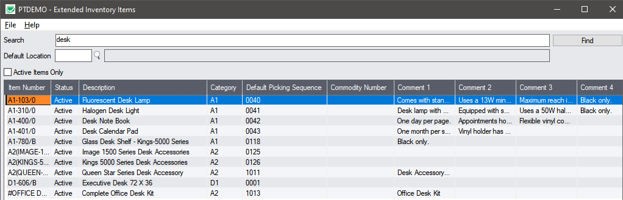
I/C Item SmartFinder
20,000 Inventory Items with Diverse Descriptions
  Wood Screw, Phillips Head, Flat Head, Steel, #8, half-inch
  0.5" Phillips Brass Screw, #8
  One-inch Metal Slotted Flat Head Screw, #4
  Robertson half-inch wood screw, zinc plated
  … bolts, nuts, washers, nails, s-hooks, spacers, rivets, clamps, …

Slide 15
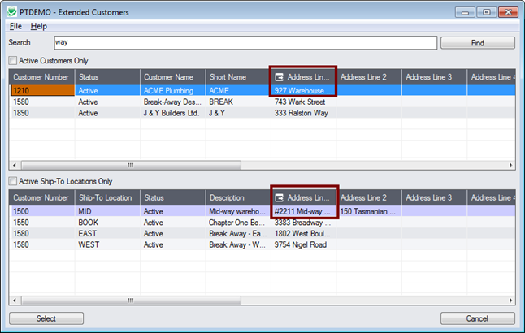
O/E Customer Finder

Slide 16
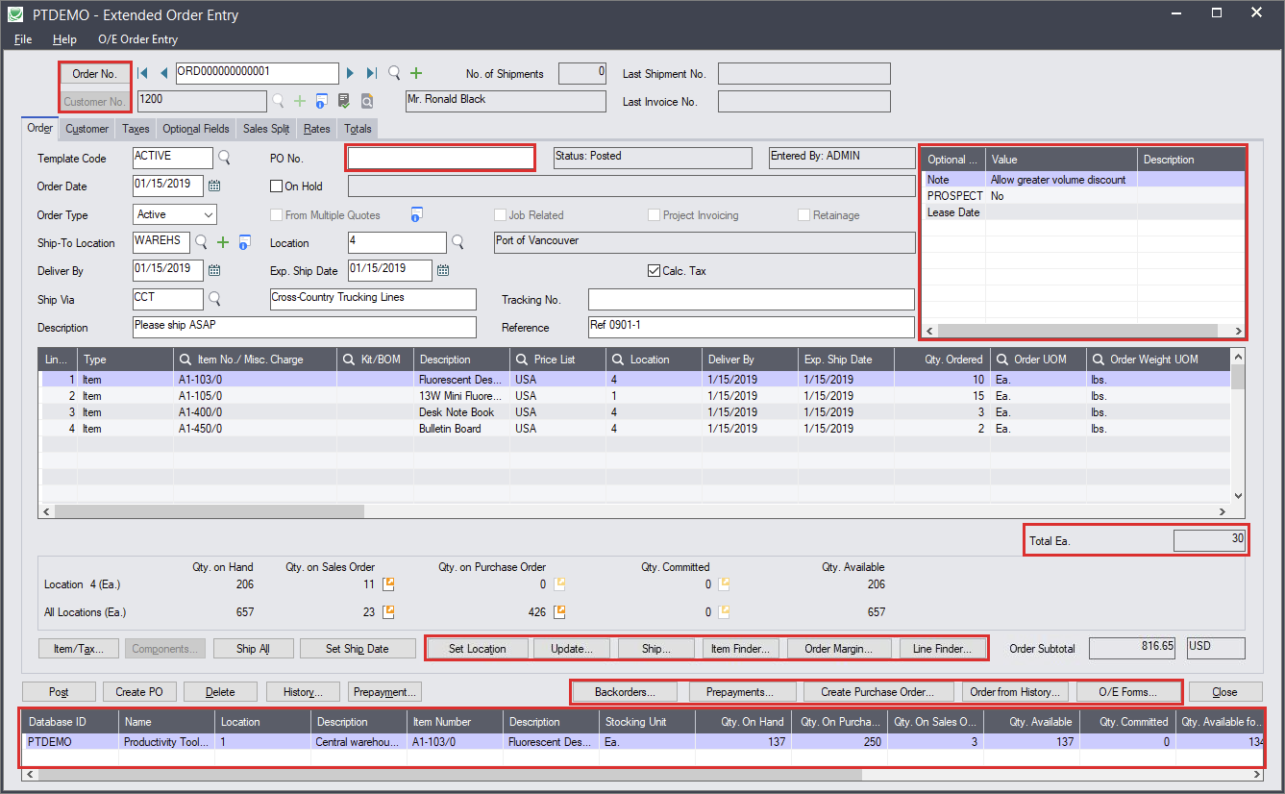
Extended Order Entry

Slide 17
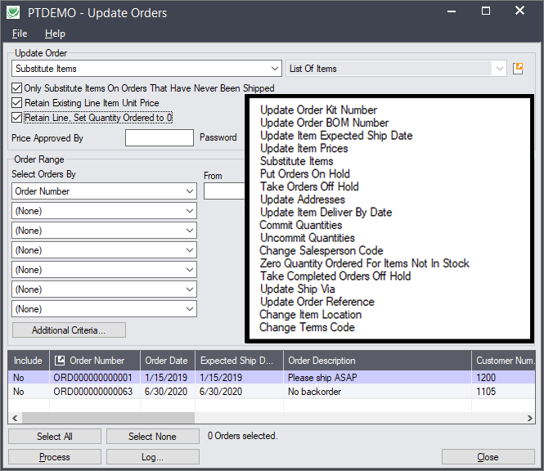
Update Orders

Slide 18
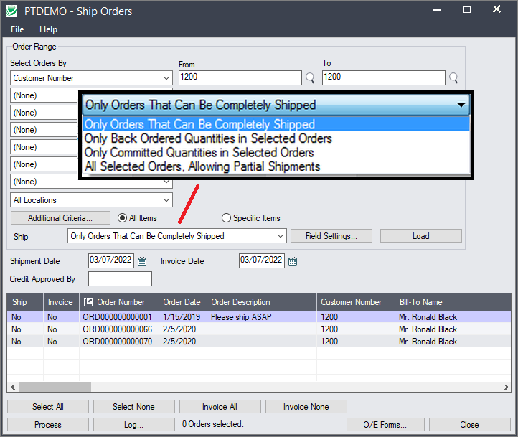
Ship Orders
Notes:
A setup and a copying program provide the new functionality. A subscription to Copy Company is included.
click
Unlike many sub-enterprise products, there are no license limitations for users or companies.

Slide 19
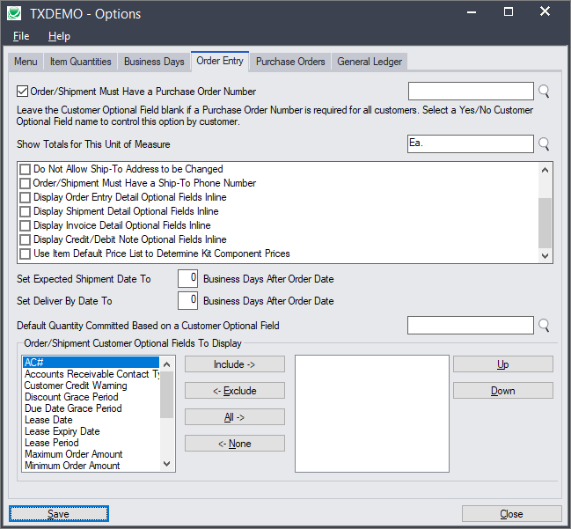
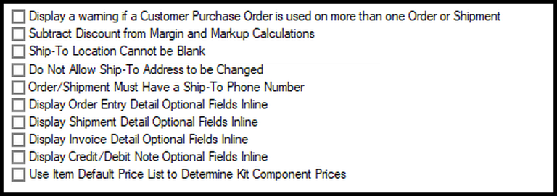
Extended Order Entry Options
Notes:
A setup and a copying program provide the new functionality. A subscription to Copy Company is included.
click
Unlike many sub-enterprise products, there are no license limitations for users or companies.

Slide 20
Productivity Tools – New Features
SmartFinders now display and search optional fields
Extended OE Credit/Debit Note Entry
  When an invoice number is entered, provides the ability to see all credit notes applied to that invoice.
Extended PO Receipt Entry
  Display a warning if quantity entered exceeds quantity on purchase order
Usability Enhancements

Slide 21
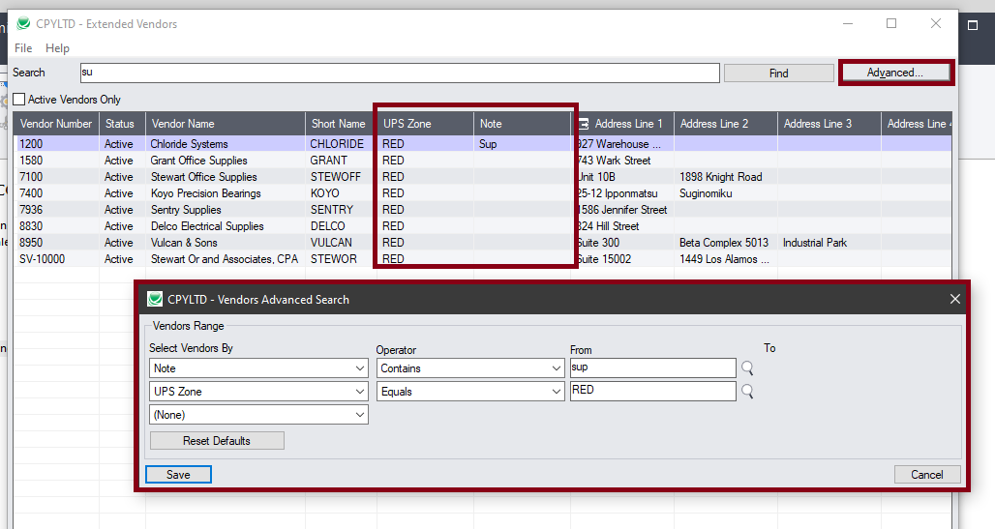
SmartFinders: Optional Fields

Slide 22
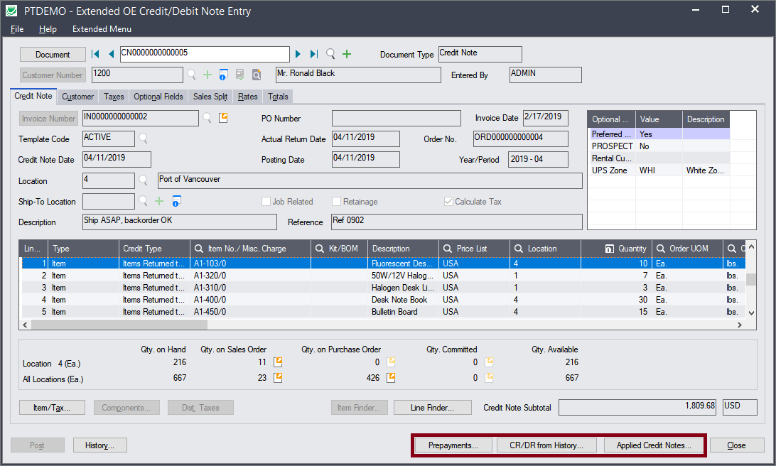
Extended OE Credit/Debit Note Entry
Notes:
A setup and a copying program provide the new functionality. A subscription to Copy Company is included.
click
Unlike many sub-enterprise products, there are no license limitations for users or companies.

Slide 23
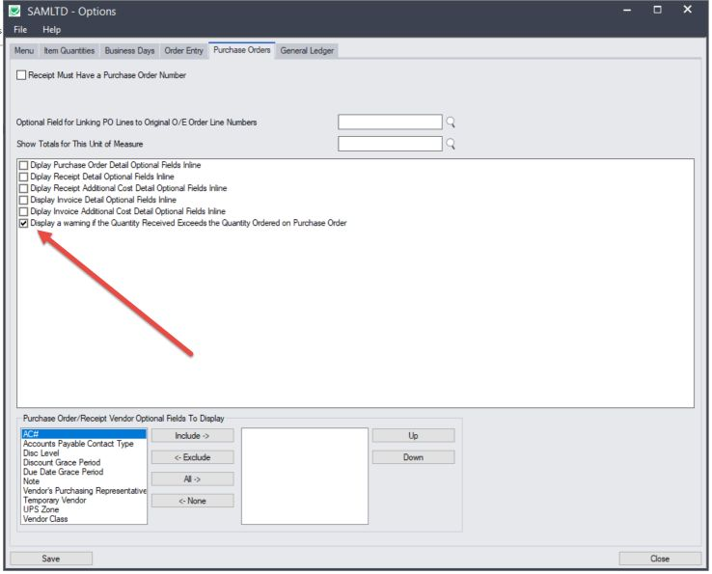
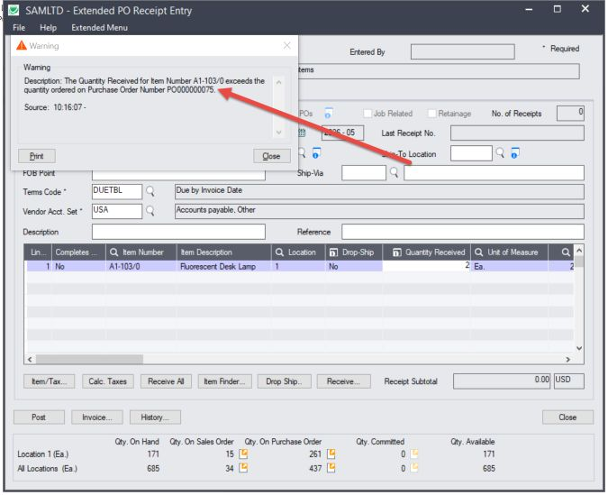
Extended PO Receipt Entry
Notes:
A setup and a copying program provide the new functionality. A subscription to Copy Company is included.
click
Unlike many sub-enterprise products, there are no license limitations for users or companies.

Slide 24
Productivity Tools Enterprise – New Features
Optional fields are displayed and editable in detail grids
Tag Posted G/L Transactions
  Categorize posted G/L transactions
Enterprise Finders
  Search for an item based on a manufacturer's item number.

Slide 25
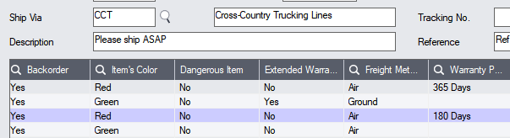
Optional Fields Editable in Detail Grids

Slide 26
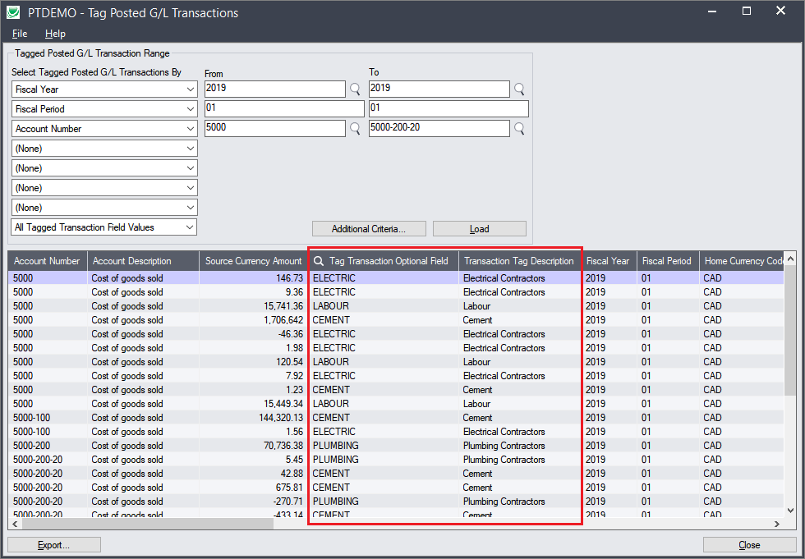
Tag Posted G/L Transactions

Slide 27
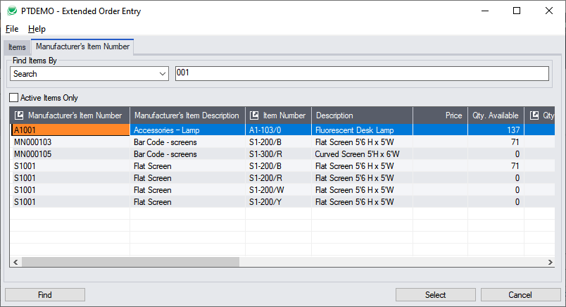
Search Item with Manufacturer's Item Number

Slide 28
Questions
?

