Slide 1

TaiRox Collections
Don Thomson, TaiRox CEO

Slide 2
Agenda
TaiRox Website Resources
Most Compelling Collections Benefits
Demonstration
New Features

Slide 3
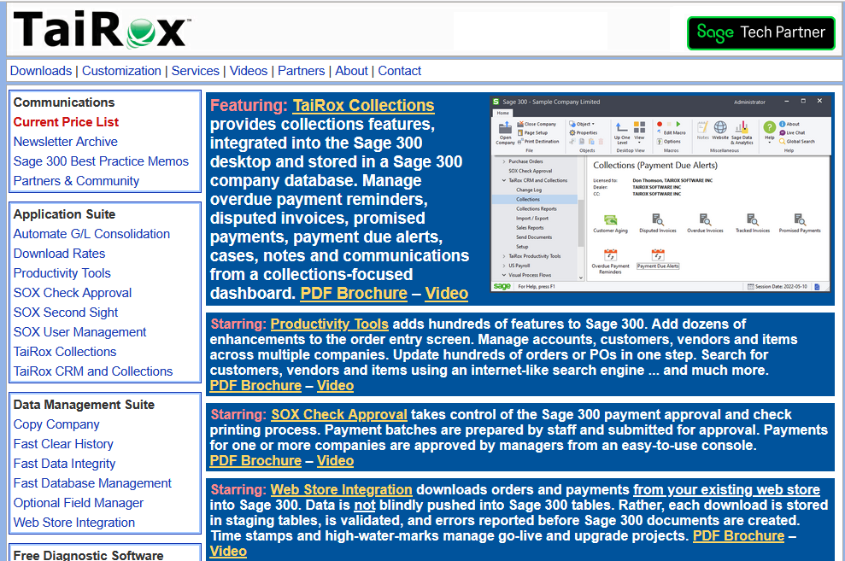
TaiRox Website
Up-to-Date
  Price List
  PDF Brochures
  Videos
  Memos
  Newsletters
  Downloads
  Release Notes
  Install Check

Slide 4
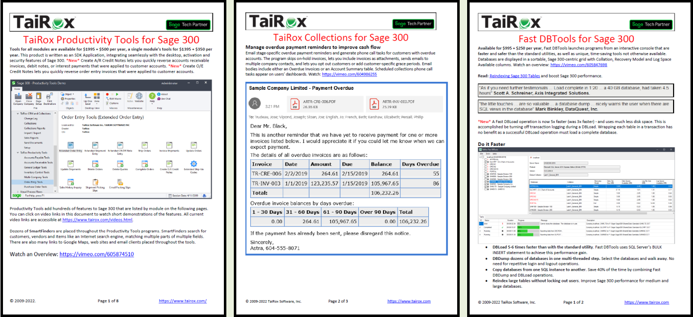
PDF Brochures with Embedded Videos

Slide 5
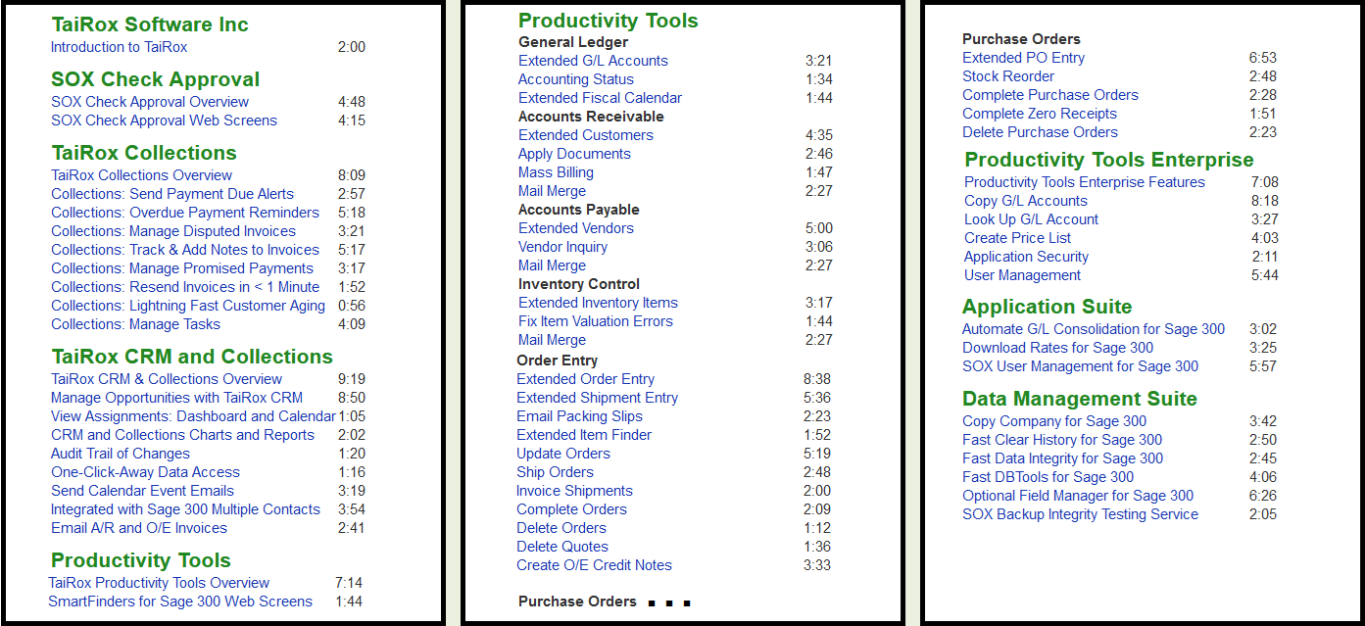
Videos Page

Slide 6
Memos: Sage 300 Technical Details

Slide 7
Collections Benefits
Primary Benefits
  Sending Overdue Payment Reminders
  Sending Invoices
  Sending Statements
  Chasing Collections
  Viewing an Enhanced Aged Trial Balance
Secondary Benefits
  Sending Payment Due Alerts
  Tracking Promised Payments
  Tracking Disputed and Large Invoices
  Assessing Collections Performance
- Easily find all communications
- Schedule hundreds of emails

Slide 8
Compelling Benefit Notes
Permanent Records
  An Overdue Invoice is a row in a table, not a transient state.
  An Overdue Payment Reminder is a row in a table.
  A Payment Due Alert is a row in a table
  A Communication is a row in a table.
Communications
  Are created automatically when emails are sent
  Link an EML file to a customer or a national account

Slide 9
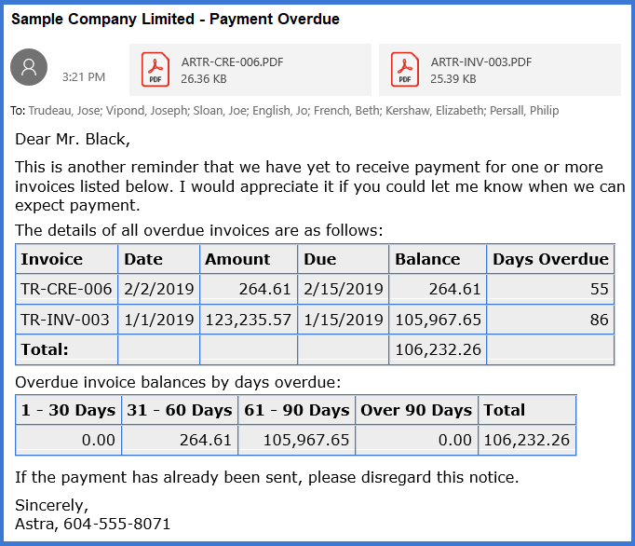
EML File Displayed in an Email Client

Slide 10
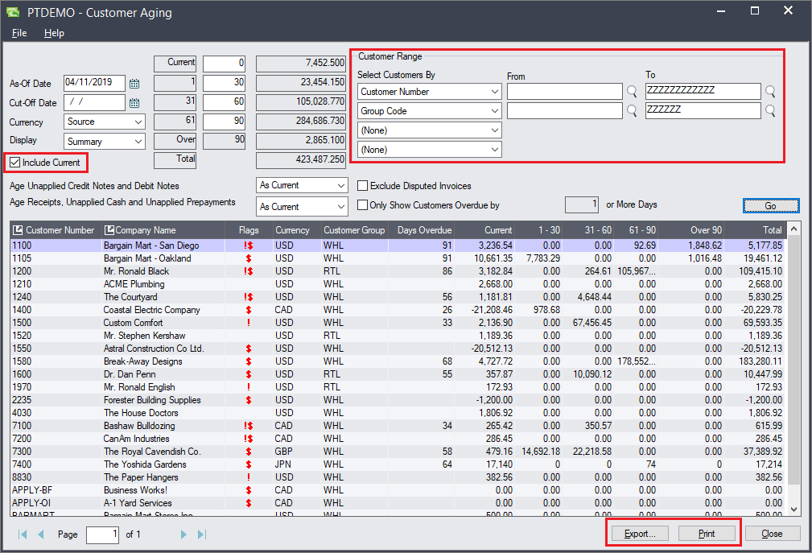
Customer Aging
Aged Trial Balance
  Fast
  Enhanced Display
  Filtering Options
  Export to Excel
  Print ATB

Slide 11
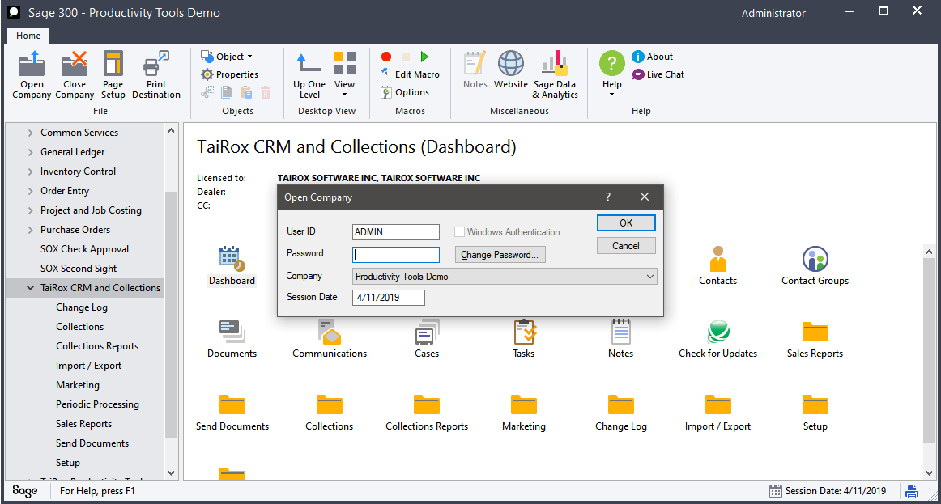
Demonstration
Log into SAMLTD on 4/30/2019

Slide 12
New Features
Scheduling
Send Statements (Statement Profiles)
French Templates
Demo Guide, Quick Start Guide
Send Invoices Individually (for automated A/P customers)
User Feedback / Consistency
  Tasks/Cases: send an email when changing an assignment
  Ability to resend documents to a non-contact
  Create a future promised payment report
  Attach documents to promised payments
  Auto-refresh cases
  Overdue payment reminders – demonstrate next cycle

Slide 13
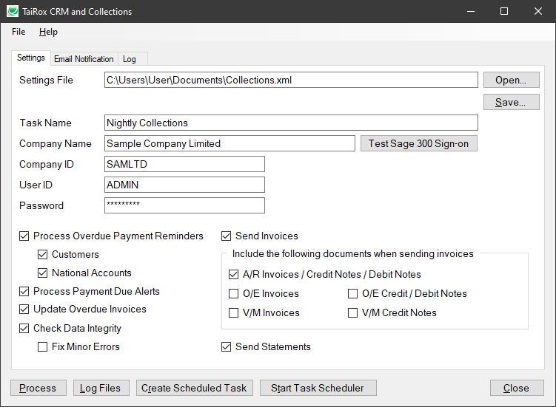
Scheduling

Slide 14
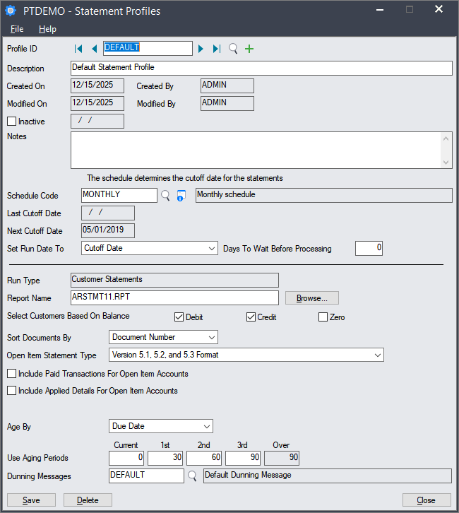
Send Statements

Slide 15
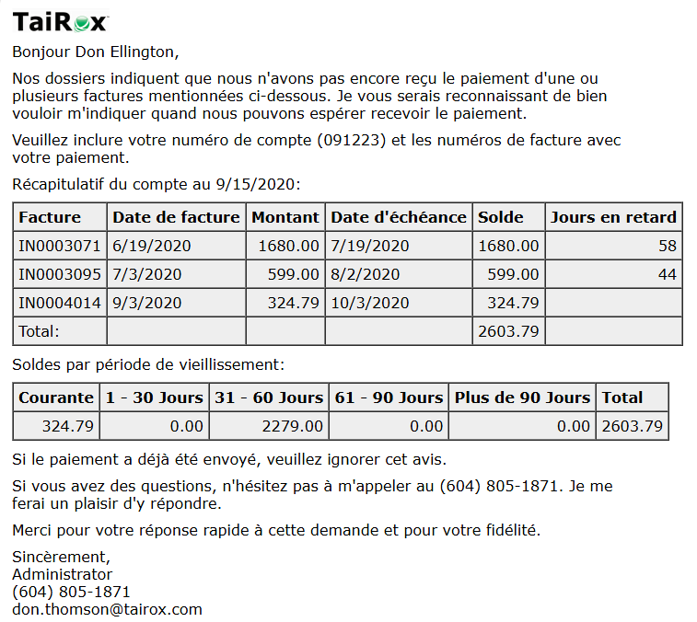
French Templates

Slide 16
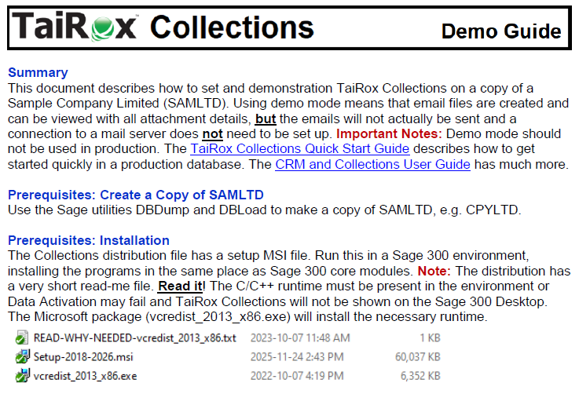
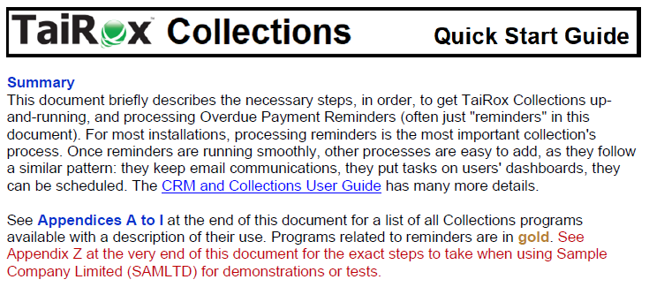
Demo Guide, Quick Start Guide

Slide 17
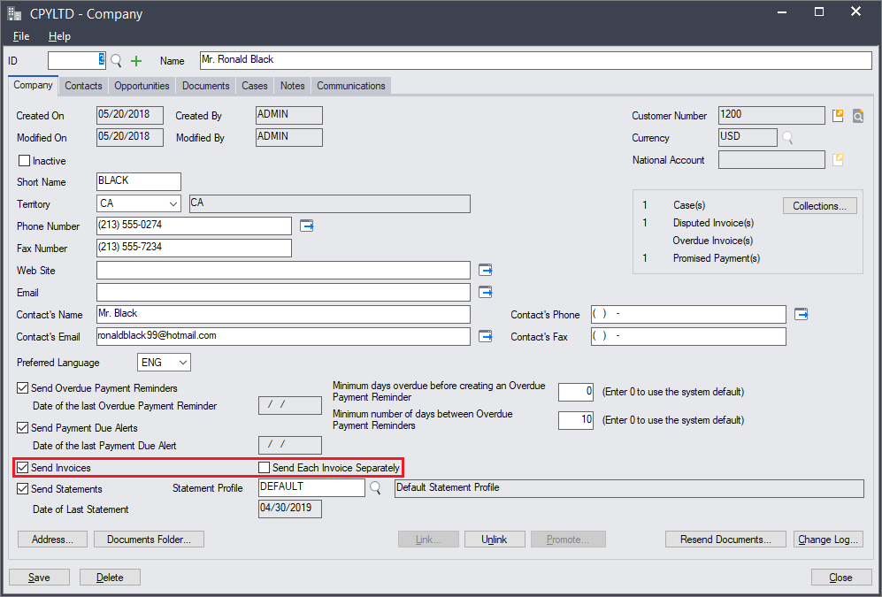
Send Invoices Individually

Slide 18
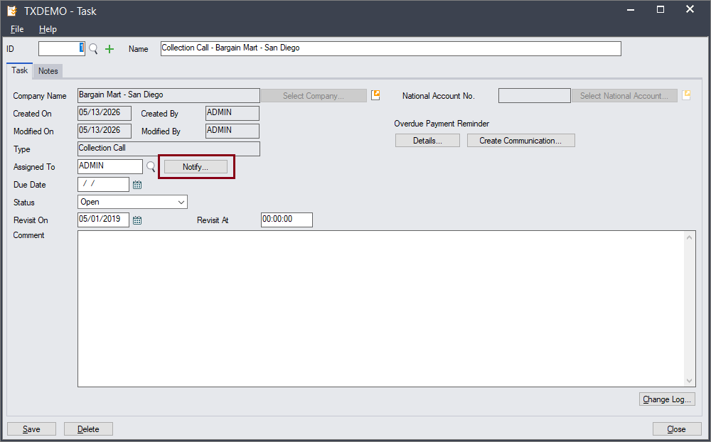
Send an Email When Changing Assignments

Slide 19
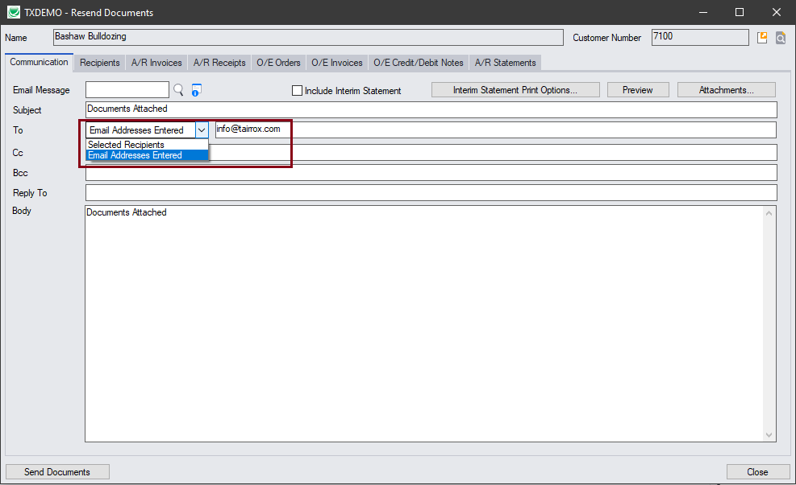
Resend Document to a Non-Contact

Slide 20
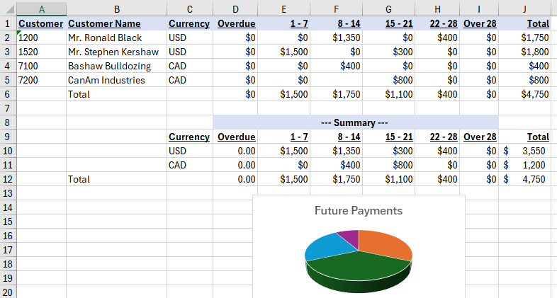
Future Promised Payments

Slide 21
Questions
?

