Slide 1

Collections Training
TPAC 2025 Preconference Training
Presented by: Don Thomson, TaiRox CEO
Notes:
What does demystifying AI mean?
It means explaining show it works – not what it does, but how it does it.
When we see the wonderful things that AI can do, when we see the silly mistakes that it makes, I want put these into a context of what it is actually doing.

Slide 2
Collections Training Materials
TPAC 2025 Essentials Link
  Link is on Partners page https://www.tairox.com/partners.html
  Collections Training PowerPoint (important notes are displayed)
  Collections Demonstration Script
  Collections Implementation Guide

Slide 3
Agenda
Benefits Reviewed, Demonstration
Implementation Planning Summary
Implementation Details
Go-Live Walk Through
Support Issues

Slide 4
Collections Benefits
Primary Benefits
  Sending Overdue Payment Reminders
  Sending Invoices
  Chasing Collections
  Viewing an Enhanced Aged Trial Balance
Secondary Benefits
  Sending Payment Due Alerts
  Tracking Promised Payments
  Tracking Disputed and Large Invoices
  Assessing Collections Performance
- Easily find all communications
- Schedule hundreds of emails

Slide 5
Collections Benefit Notes
Permanent Records
  An Overdue Invoice is a row in a table, not a transient state
Communications
  Created automatically when emails are sent
  Link an EML file to a customer or a national account
CRM & Collections Companies
  Companies are prospects or customers
  Companies extend customers (add fields)
  Company and customer fields are the same size

Slide 6
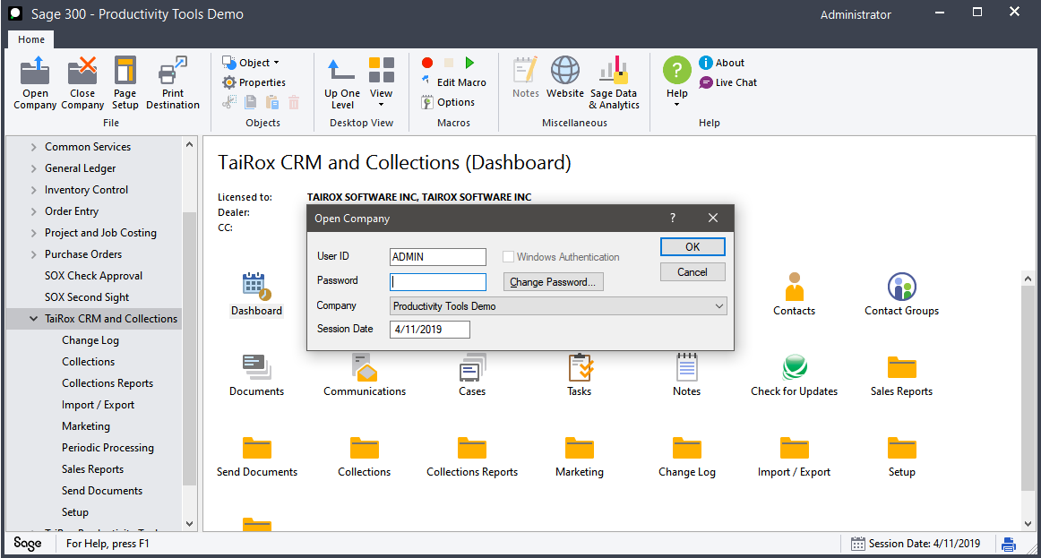
Demonstration
Log into SAMLTD on 4/11/2019

Slide 7
Implementation Planning Summary – 4 Phases
1: Demonstration
  Debug your email templates & file storage locations
2: Document Your Installation Plan
  Fill in the Collections Implementation Guide with your client
  Important: Users, Optional Fields, Communications and Attachments
3: Interactive Production
  Go-Live, following your plan
  Review design decisions with users
4: Scheduled Production (optional)
  Scale up for large volumes

Slide 8
Email Templates
Use a reasonably sized logo file
Use a simple text or HTML editor
Use only ANSI or UTF-8 characters
Test with multiple email clients

Slide 9
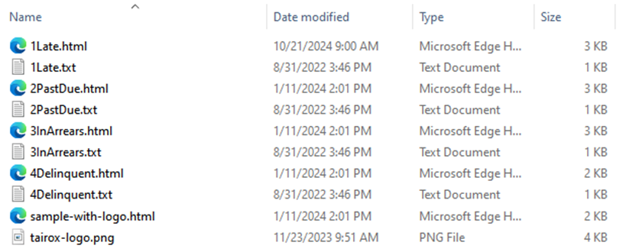
Email Templates
Use a reasonably sized logo file
  Put embedded logos and pictures in the email templates directory
  The HTML below displays a 4kb file and a 4mb file the same way
  <img src="tairox-logo.png" width="106" height="27">
  The email body includes an embedded copy of the logo file

Slide 10
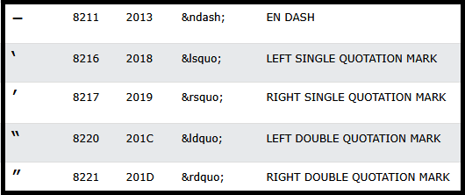
Email Templates
Use a simple text or HTML editor
  Change the words between <td> and </td>
    <td>If payment has already been sent, please disregard this notice.</td>
  Use HTML codes e.g. &rsquo; not ’ (or just use ')

Slide 11
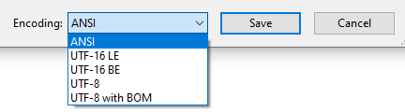
Email Templates
Use only ANSI or UTF-8 characters
French and English are supported
  &eacute; is safer than é

Slide 12
Email Templates
Test with Multiple Email Clients
  Office 365
  Gmail
  Apple Mail
  Outlook
  Thunderbird
  Clean Email

Slide 13
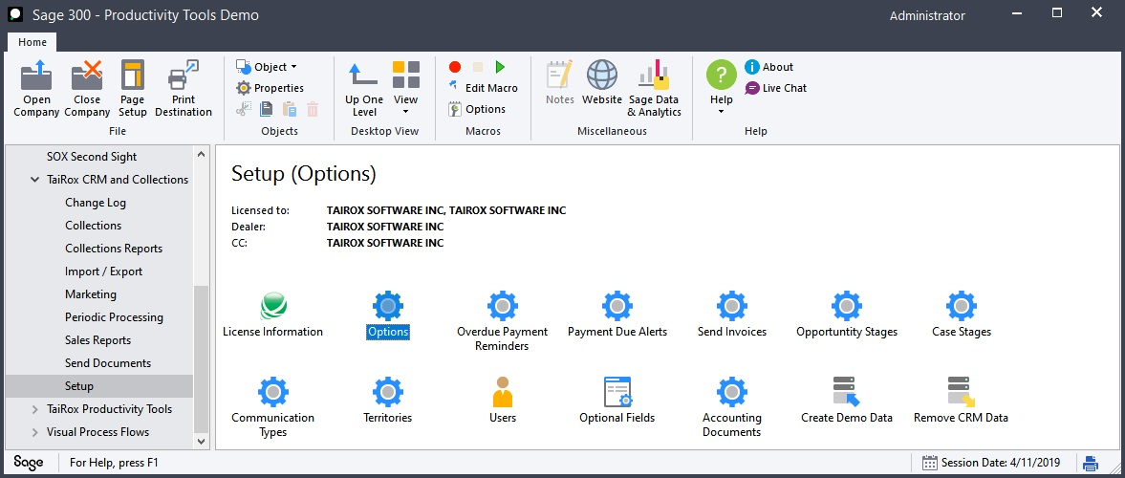
Setup - Options

Slide 14
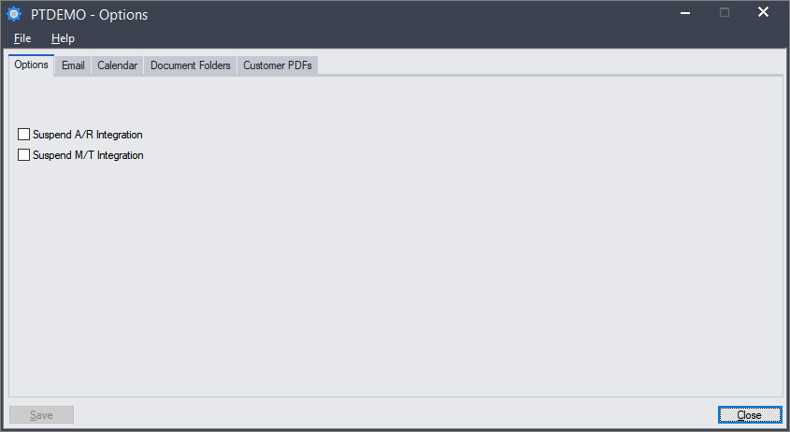
Options – Options Tab
Suspend When Running Sync Functions
  A/R – To seed X/Q Companies from A/R Customers
  M/T – To seed X/Q Contacts from M/T Contacts (or vice-versa)

Slide 15
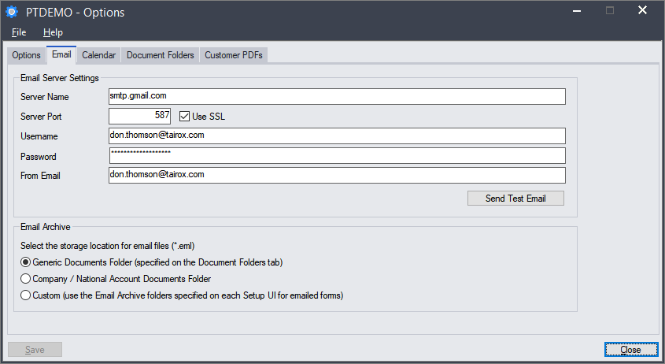
Options – Email Tab

Slide 16
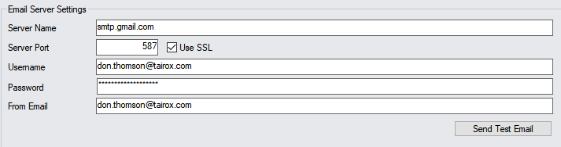
Options – Email Tab, Send Test Email
XQ.ini file has an [Email] section
  ;; Connect Timeout in seconds. Default is 30. MS Office can time out.
  ConnectTimeout=30
  How do you know if the connection has timed out?
Chilkat log file
  File is created in <Shared Data>\COMPANY\TaiRox CRM\Logs
  Filenames will look like EMAIL250150425153308.log

Slide 17
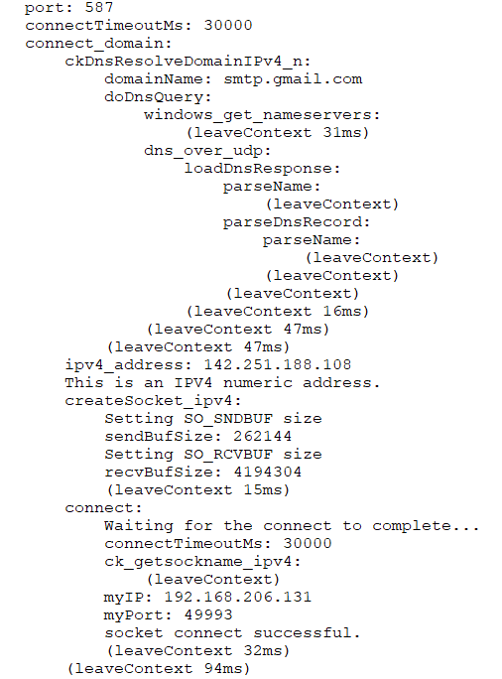
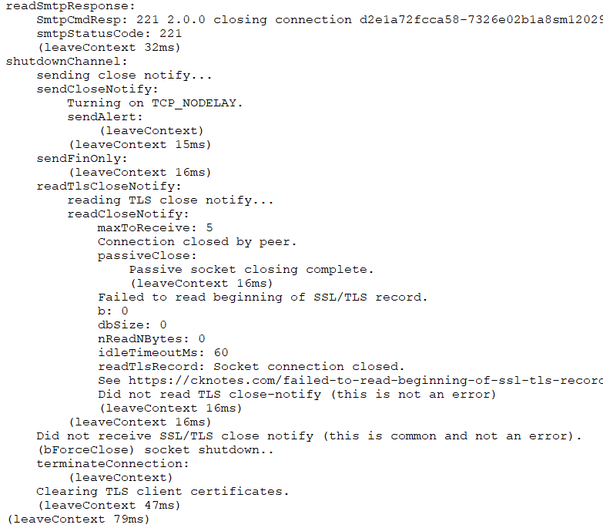
Options – Email Tab, Send Test Email
Dozens of interactions, hundreds of logged lines

Slide 18
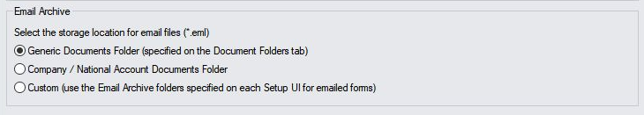
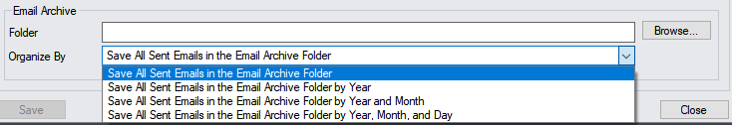
Options – Email Tab, Email Archive
Where Do You Put the Email Files? Pick Custom
  Generic and Company / National Account are for compatibility with early releases of CRM & Collections. The early idea was that they were filed with other documents.
  Custom: Specify for each kind of communication:

Slide 19
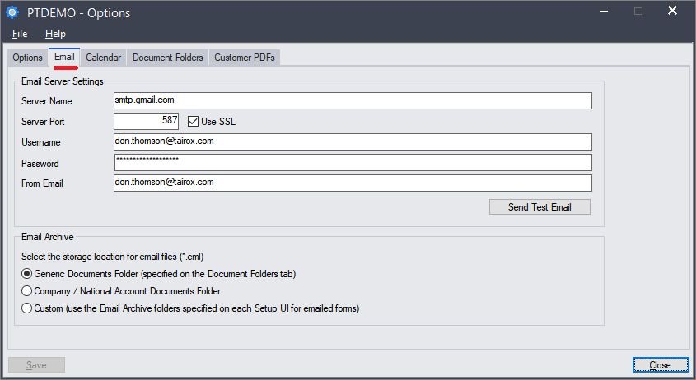
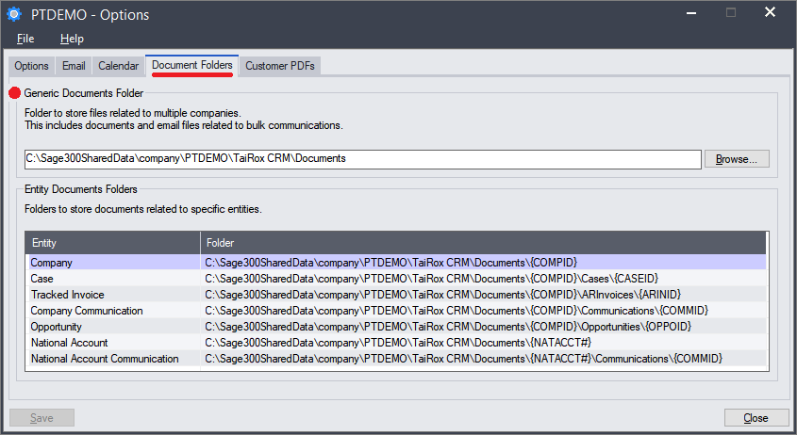
Options – Document Folders Tab
• Generic Documents are created without being linked to any specific company - and can later be linked to multiple companies.

Slide 20
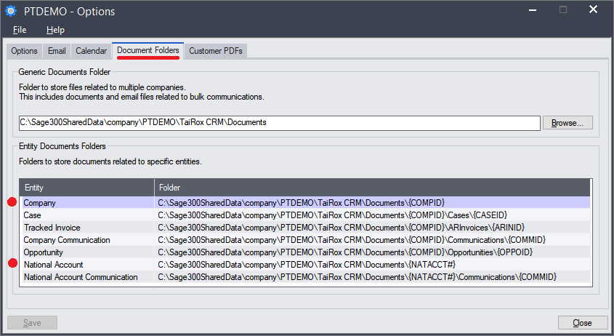

Options – Document Folders Tab
• Company-specific documents are linked to one and only one company. Ditto for National Accounts.

Slide 21
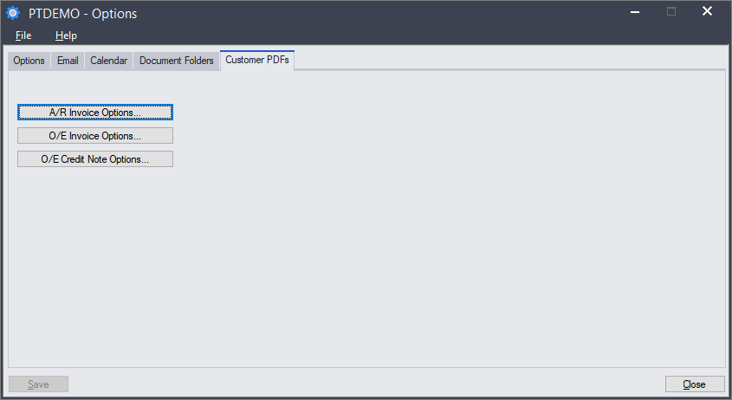

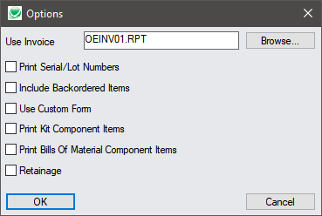
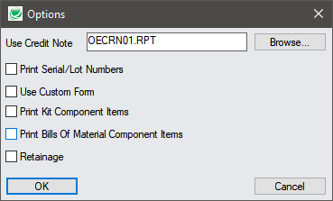
Options – Customer PDFs Tab
Attachments are Standard Sage 300 Documents
(not shown) V/M Invoice Options, V/M Credit Note Options

Slide 22
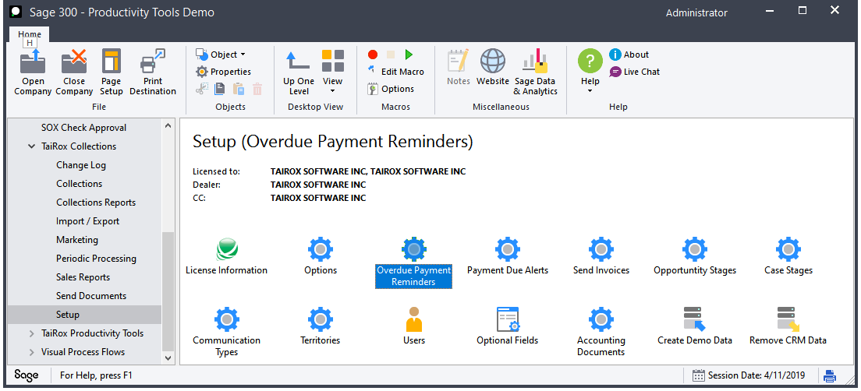
Setup – Overdue Payment Reminders

Slide 23
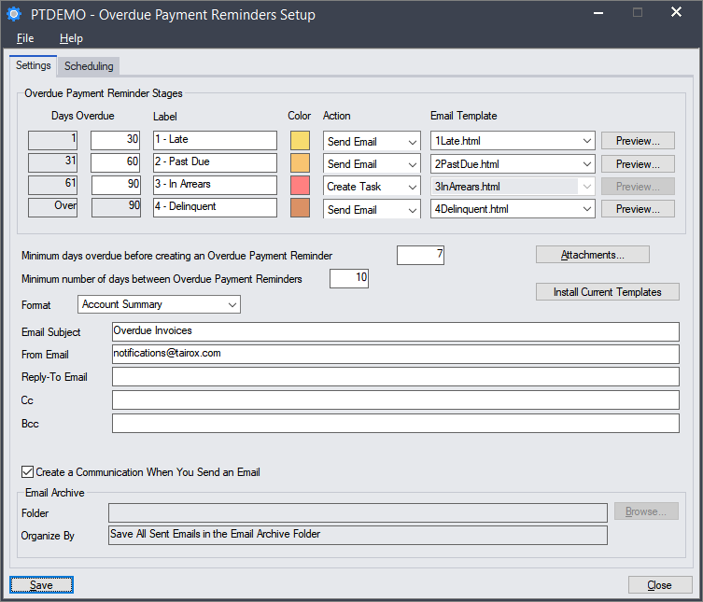
Overdue Payment Reminders Setup

Slide 24
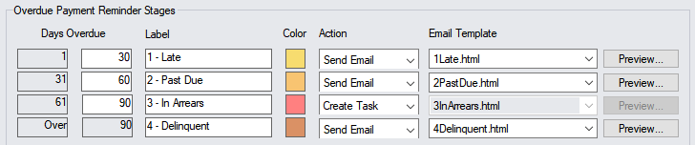
Overdue Payment Reminders Setup
There is nothing magical about 30-60-90
Double-click to change the color
Send Email and Create Task can be in any order
Preview will prompt for Customer or National Account

Slide 25
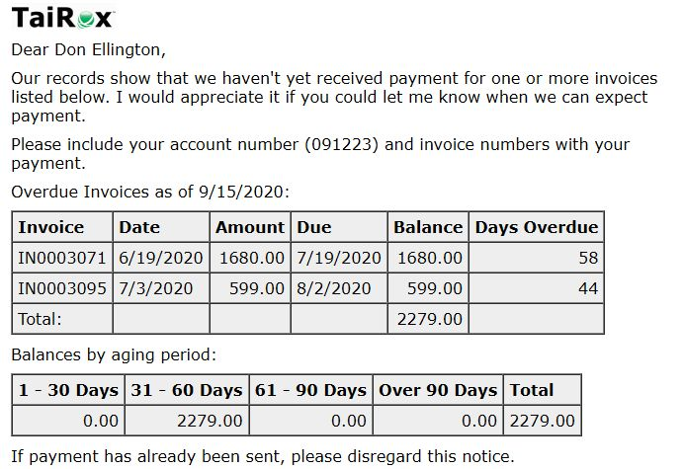
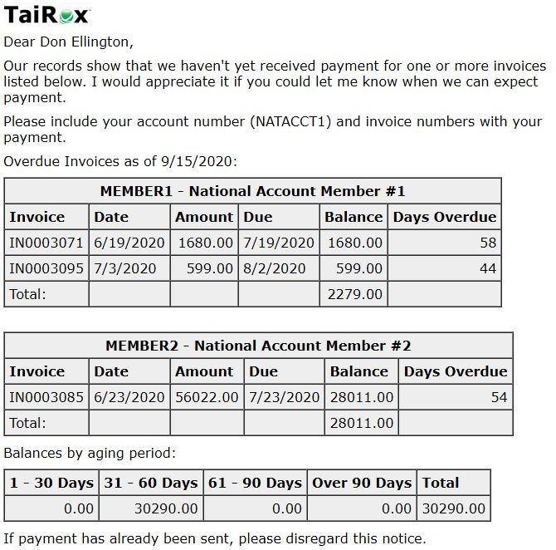
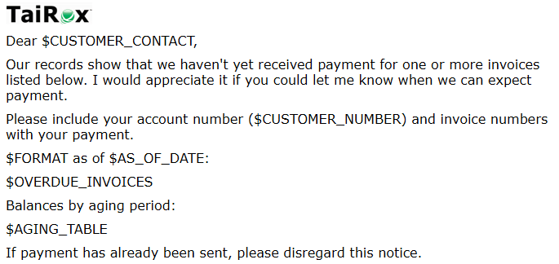
Overdue Payment Reminders Setup
Customer Preview
National Account Preview
Don't Add Anything between td's:
<td>$OVERDUE_INVOICES</td>

Slide 26

Overdue Payment Reminders Setup
"Grace Period"
  You may already have the check and not yet entered or applied it
"Spam Period"
  You may want to avoid too much duplication
Attachments are sent with every reminder
Account Summary is a "Statement-of-the-Moment"
  Avoids a common stalling tactic

Slide 27
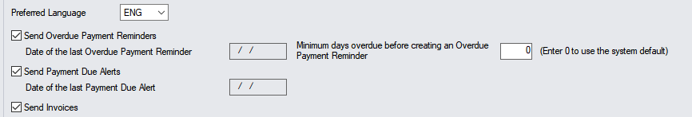
Overdue Payment Reminders Setup
Company-Specific Settings / Overrides

Slide 28
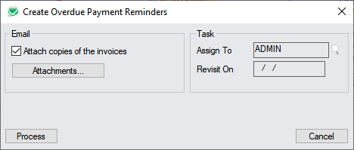
Sending Reminders
Should you attach invoices to overdue payment reminders?
  Pros: The chased customer is less likely to ask for these
  Cons: Consumes lots of time sending, uses network storage
  Consider how this relates to the Spam Period
Creating communications (and EML files) is also optional

Slide 29
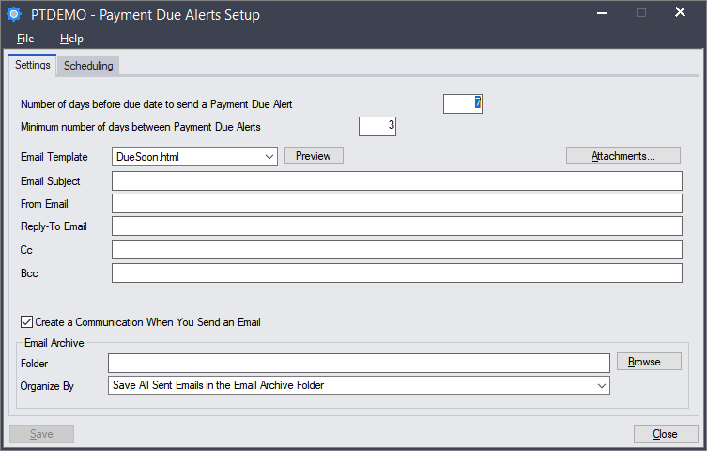
Payment Due Alerts Setup

Slide 30
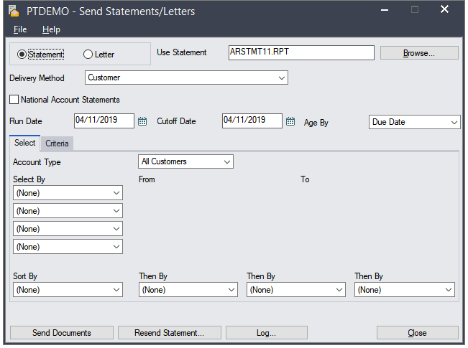
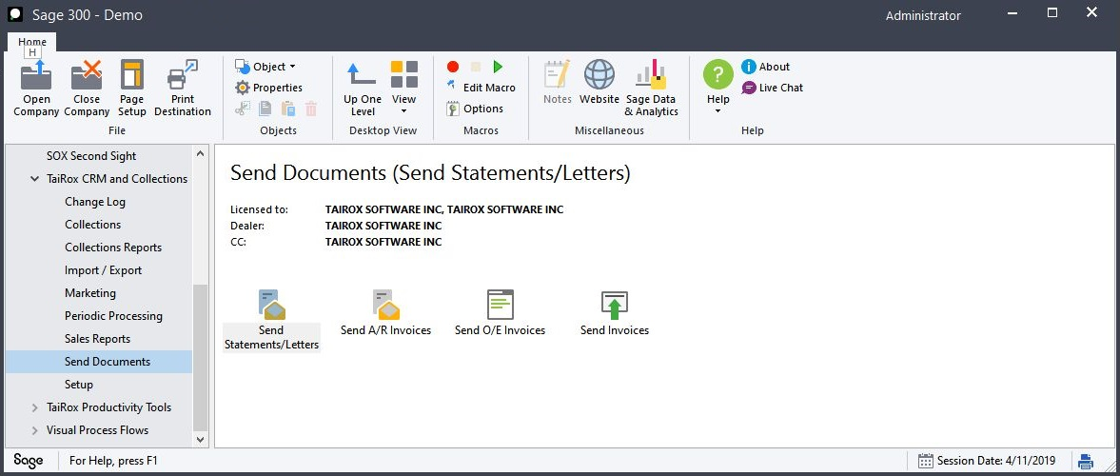
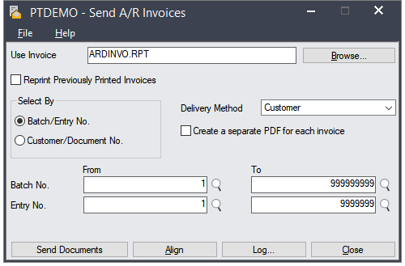
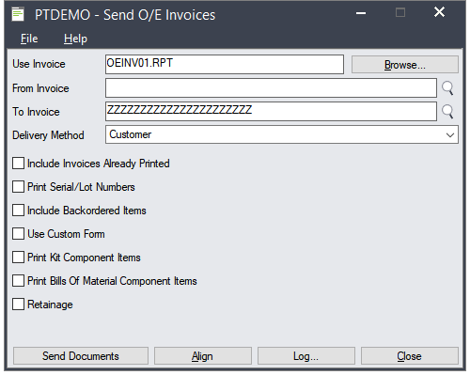
Sending Documents Programs
3 Sends "Just Like Sage"

Slide 31
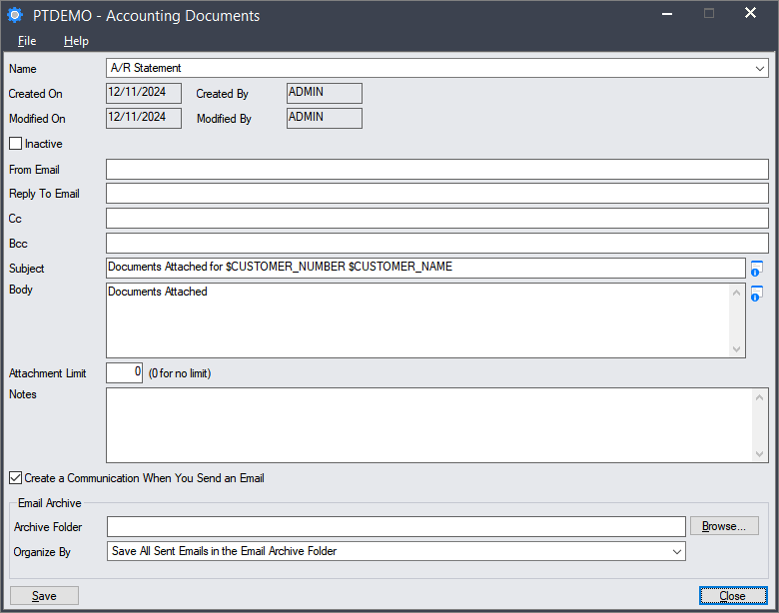
Accounting Documents Setup
3 Sends "Just Like Sage" are setup up in Accounting Documents

Slide 32
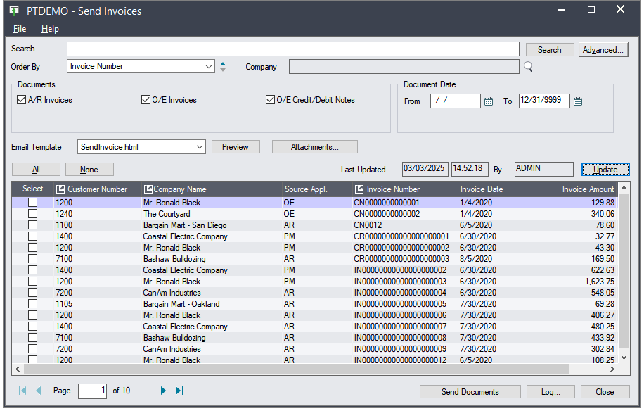
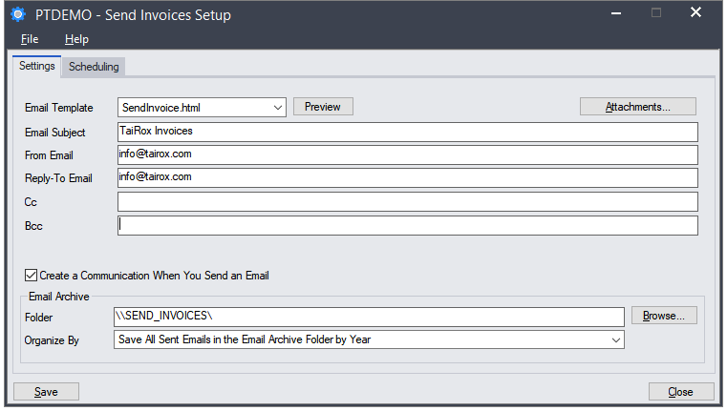
Send Invoices – Not "Just Like Sage"
Sending Invoices Only – No Printing, HTML Template, Schedule

Slide 33
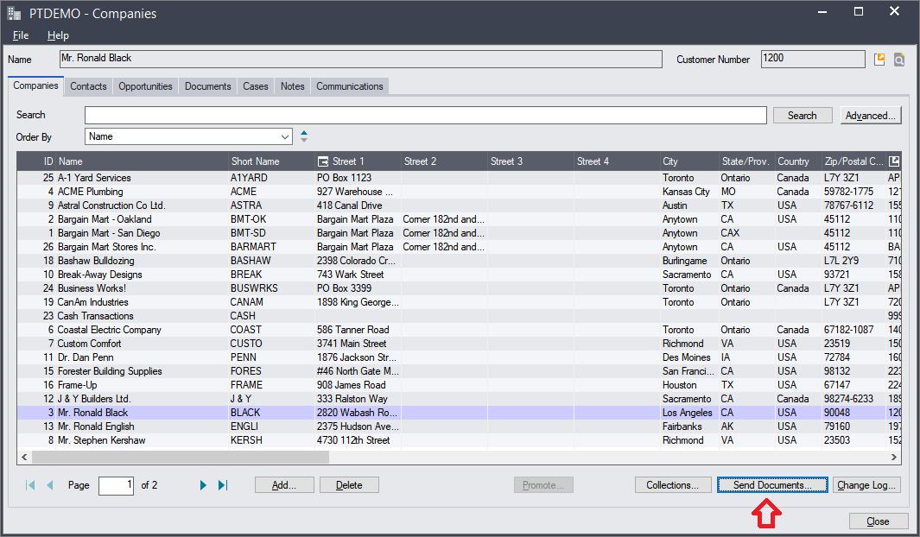
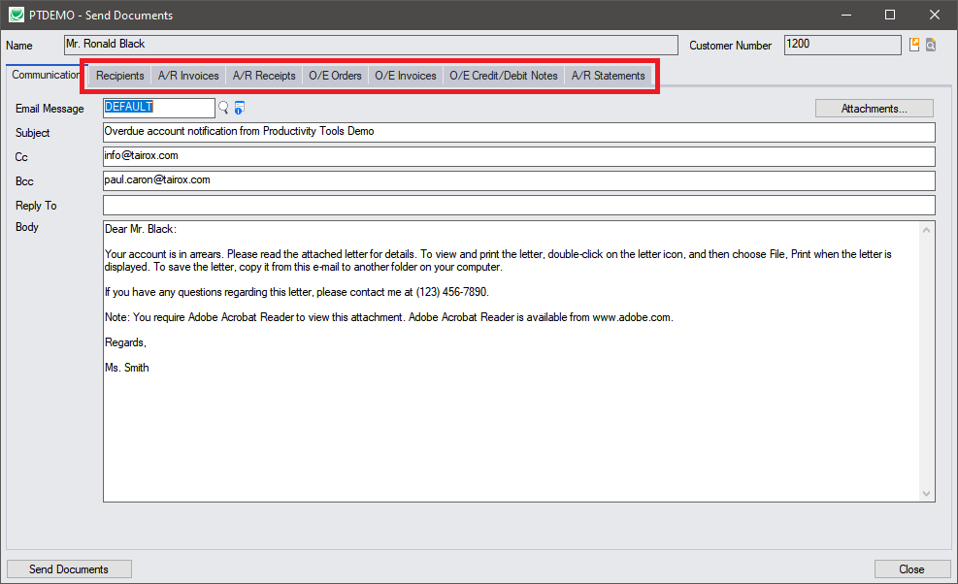
Chasing – Send Ad-Hoc Documents

Slide 34
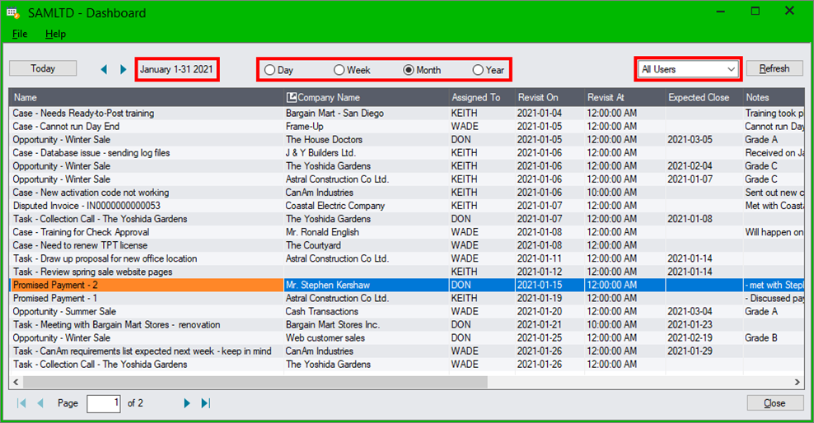
View on Dashboard – Never Forget
To defer a task means to change the revisit date
Management
  View all users' tasks
  There is a change log
Tasks – you need to phone a customer
Promised Payment – check that the payment has arrived
Disputed Invoice – find out what has been done to resolve

Slide 35
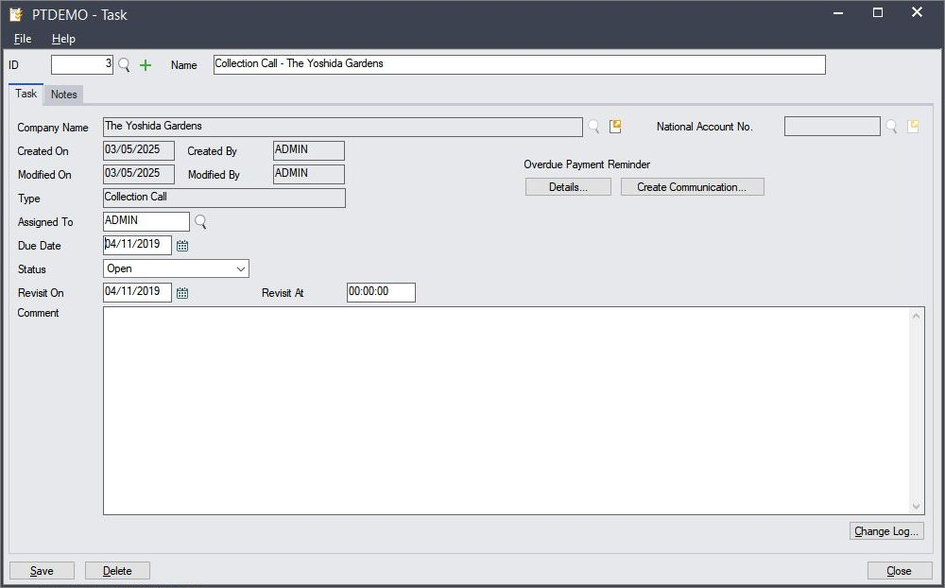
Tasks on the Dashboard
Connected to:
  A Company
  A National Account
  Not Connected
Automatically created tasks are always connected.
  Once connected, the connection cannot be changed.

Slide 36
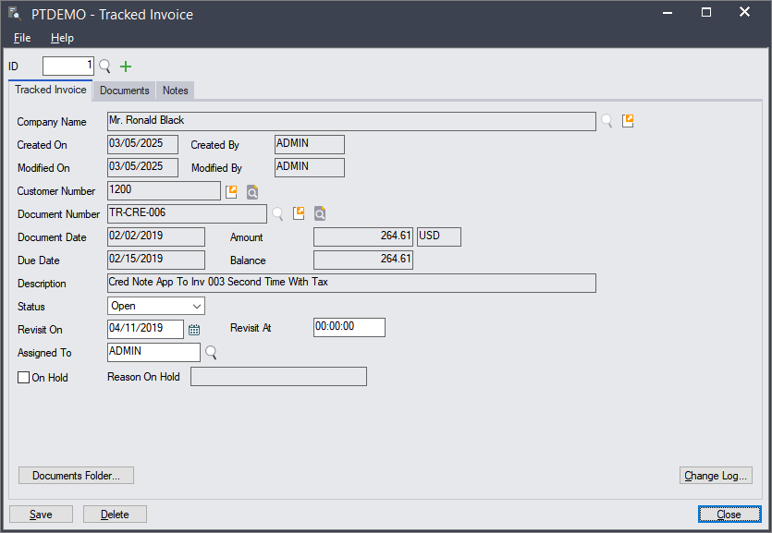
Tracked Invoices on the Dashboard
An overdue invoice is always a tracked invoice.
A tracked invoice need not be an overdue invoice because some large invoices are tracked from day one.

Slide 37
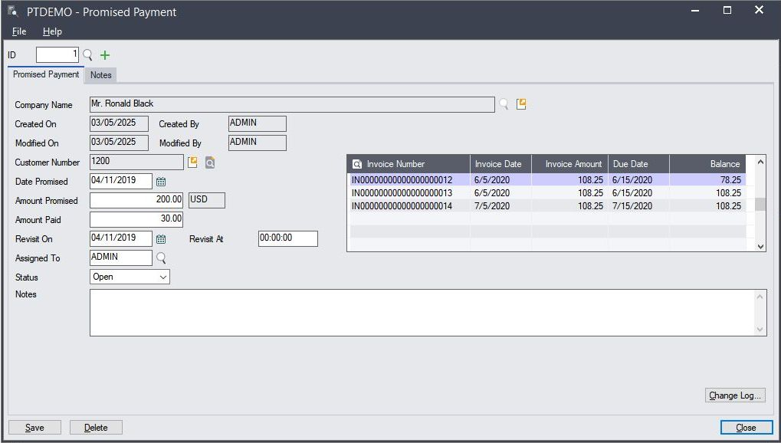
Promised Payments on the Dashboard
Can be related to zero or more invoices

Slide 38
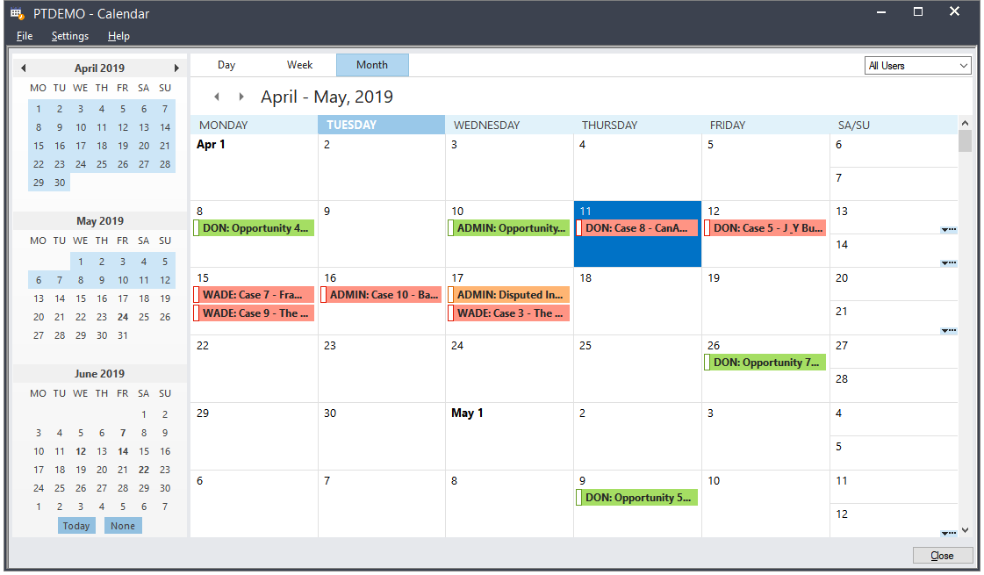
View on Calendar
Same information as on Dashboard

Slide 39
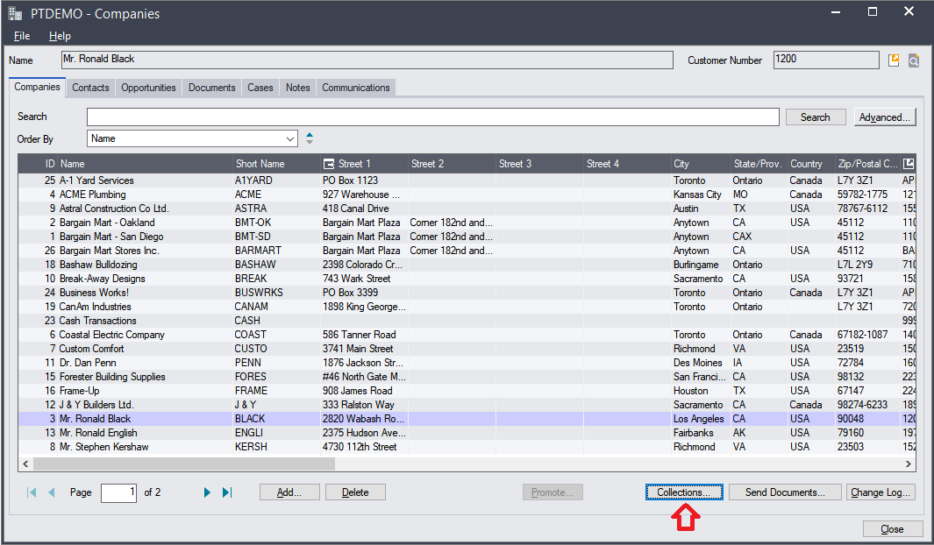
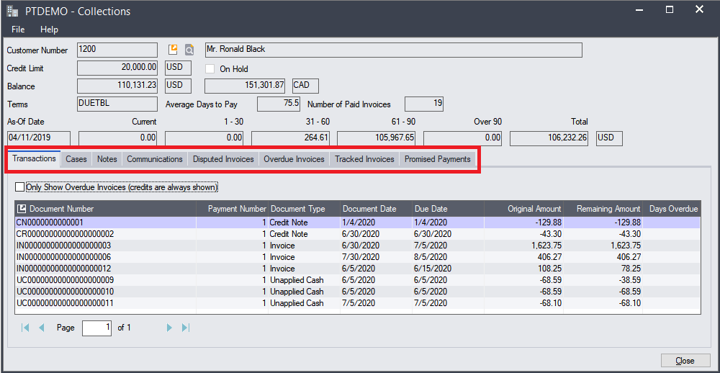
View on Collections Inquiry
Launch from Companies screen
All information related to collections – similar to customer inquiry

Slide 40
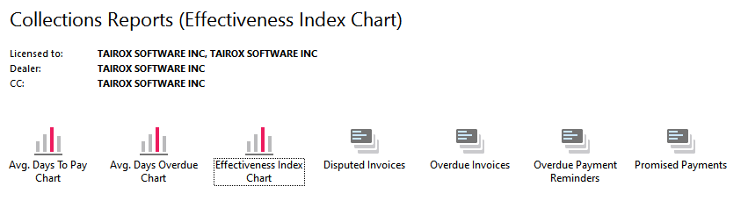
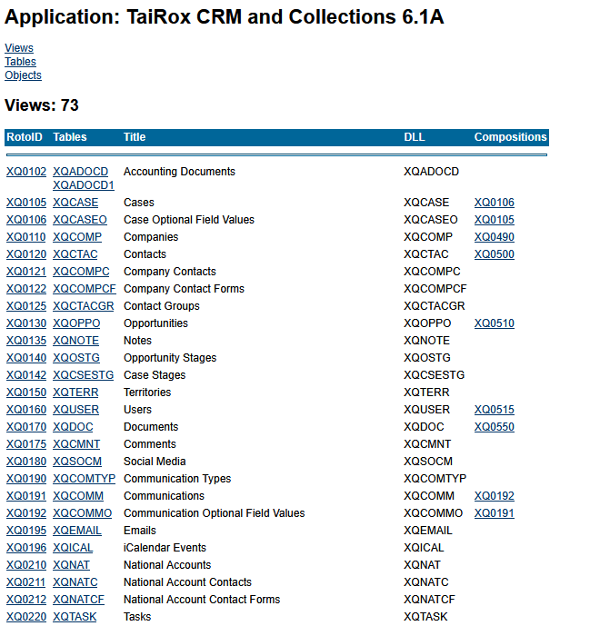
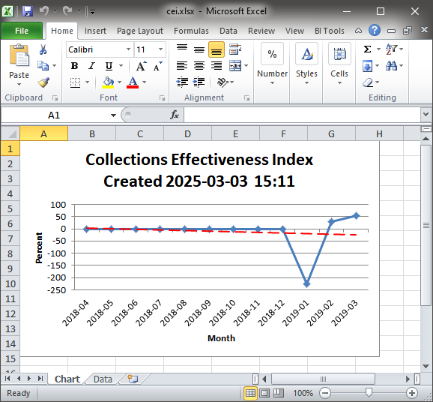
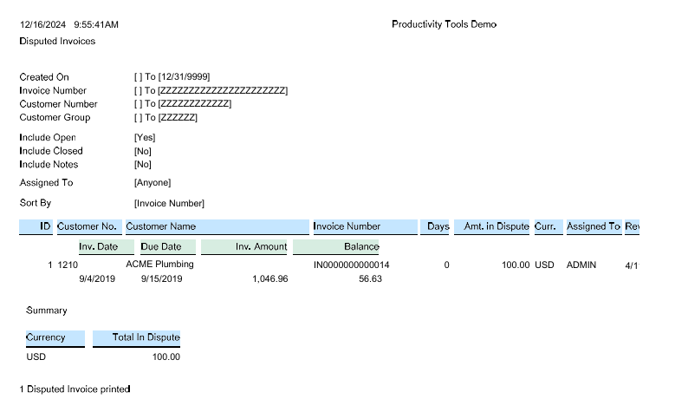
Collections Reports

Slide 41
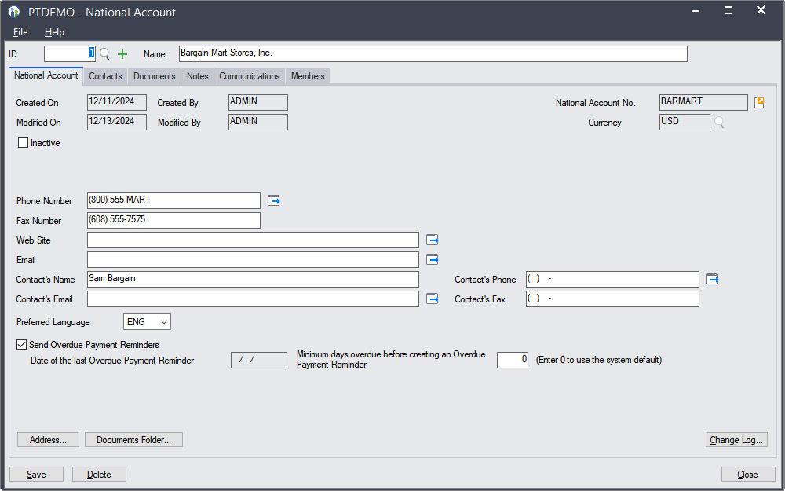
National Accounts
TaiRox national accounts extend Sage national accounts
  Just like TaiRox companies extend Sage companies
  Members tab provides a convenient list of members

Slide 42
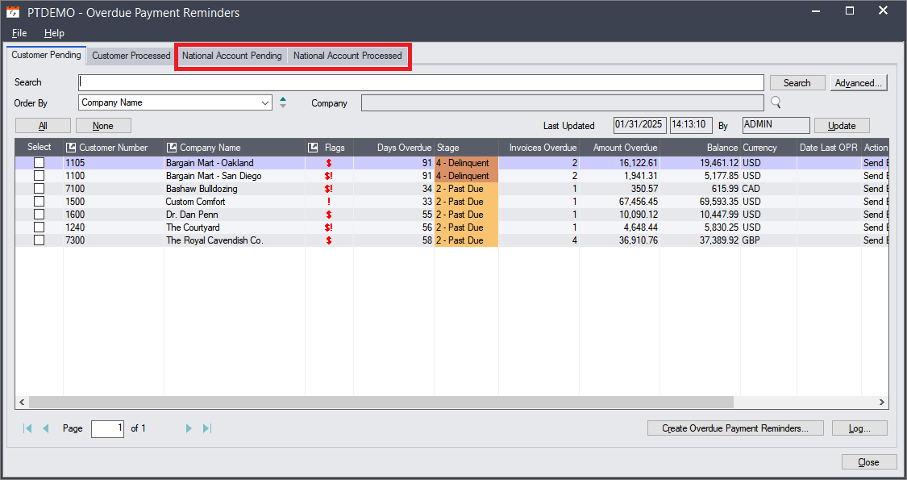
National Account Overdue Payment Reminders
Process either company or national account reminders

Slide 43
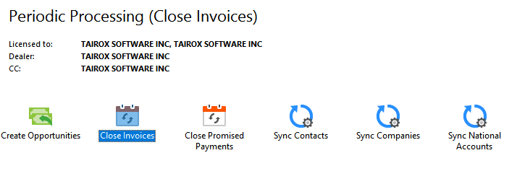

Periodic Processing

Slide 44

Scheduler Program
A Windows Scheduled Task
Sends "Unprinted" Invoices
Preferred Language Support

Slide 45

Overdue Payment Reminder Scheduling Options
Options must be specified that are normally entered interactively or taken from the logged-in user.

Slide 46
Go-Live Walkthrough
Standard Steps
  Lock Users Out of Production Database, Backup Database
  Log into Sage 300, Activate CRM & Collections
Following Your Collections Plan
  Add Optional Fields (before Syncs)
  Sync Contacts (before other Syncs)
  Sync Companies & National Accounts (if applicable)
  Add Territories and Users
  Set up All Collection Options
Standard Steps
  Add Security Groups
  Add Collections Users to Security Groups

Slide 47


Support – Data Integrity
Sage Data Integrity
Fast Data Integrity

Slide 48

Support – Install Check

Slide 49

Support
We are stumped by some emails from consultants

Slide 50
Support
If You Cannot Drag and Drop
  Windows does not allow you to drag from an insecure area to a secure area
  If you run Sage 300 "as admin", Sage 300 SDK screens are considered secure areas

Slide 51
CRM Features – What Does CRM Add?
Sales Reports Folder
  Sales Pipeline, Open Opportunities, Time to Close, Sales Activity
Marketing Folder
  Bulk Email Accounts, Send Bulk Email, Contact Groups
Import/Export Folder
  Companies, Contacts, Notes
Cases
  Largely replaced by Tasks, Promised Payments, Disputed Invoices

Slide 52
Questions?

