Slide 1
TaiRox Preconference Training
Integration, What's New

Slide 2
Training Agenda
Integration
Vault and Store Databases (SQL Server Integration)
How Integrations Should Work
Large and Larger - What TaiRox is Seeing More Of
Web Store Integration
TaiRox Support
TaiRox Products: What's New

Slide 3
SOX User Management and 2024 Security
Vault and Store Databases
ISAM user data is now stored in SQL tables
Adds a SQL Server user layer
User roles for each database
Once set up, how would you migrate?
Export/Import: passwords are not copied
Backup/Restore: master database entries!

Slide 4
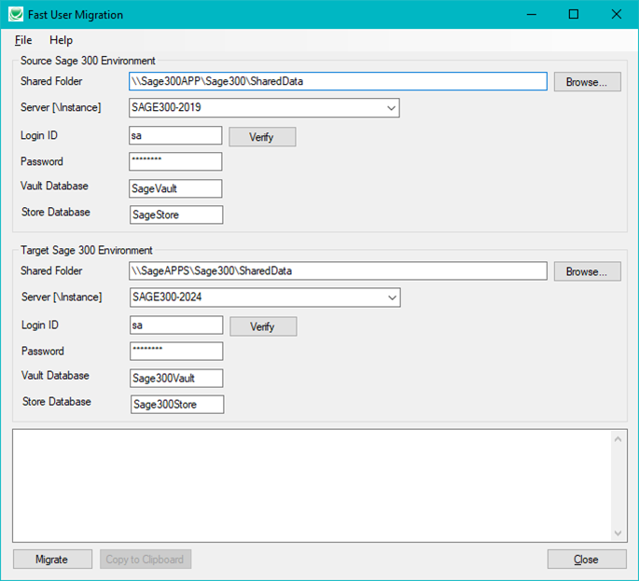
Fast User Migration

Slide 5
Fast User Migration
Migrates all user information from the source databases to the target databases, including passwords and email settings.
Performs INSERTS only on the target databases, so you can migrate new users but cannot update user accounts.
Does not create the ADMIN or GUEST logins in the target environment. These logins are created by Sage 300 when you set up a new Sage 300 environment.
https://vimeo.com/914857964

Slide 6
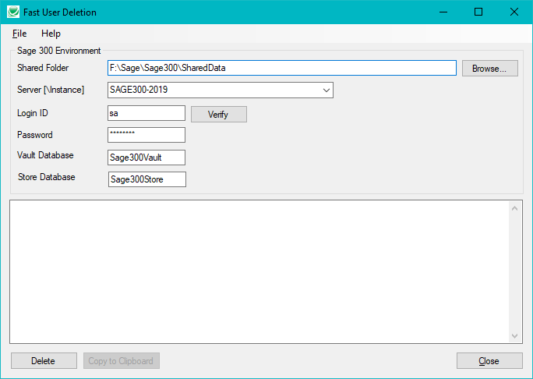
Fast User Deletion

Slide 7
How Integrations Should Work
Sage 300 is Not "Always On"
A 7x24 website cannot always (in real time) push data all the way into Sage 300 databases.
Option 1: Sage 300 pulls data from a web API, FTP site, or local file.
Option 2: High end automation might involve MS Message Queueing, which is designed to be always on.
Data Can Become Inconsistent
Staging tables separate the download, validation and processing steps, allowing corrections to be made on the website, in the staging tables, or in Sage 300

Slide 8
Large Distribution Companies
Warehouses
Third-Party Manufacturers (TPM)
Third-Party Logistics (3PL)
Automation

Slide 9
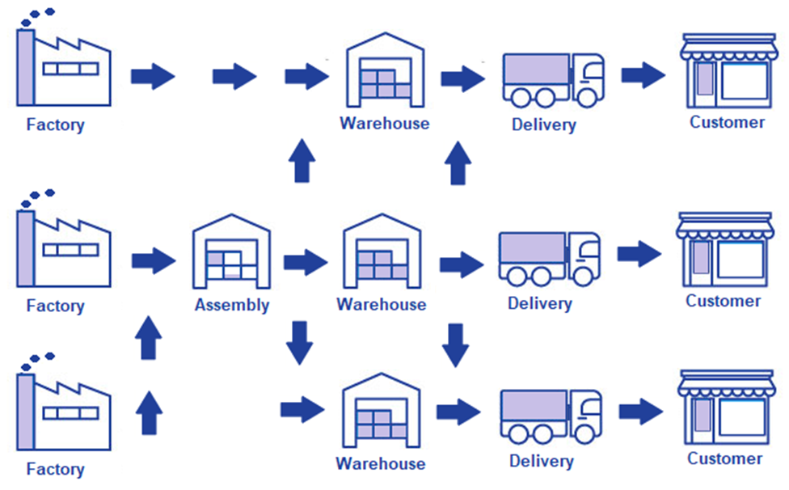
Larger Distribution Companies

Slide 10
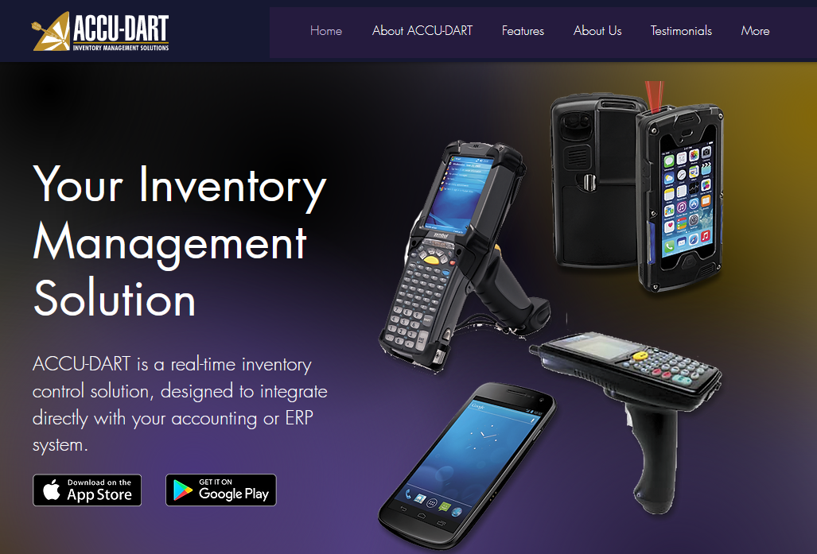
ACCU-DART Update
Executive Concepts Inc. and TaiRox Software Inc. have entered into an agreement related to the improvement, support, maintenance and customizations for the integration of Sage 300 with ACCU-DART: a real-time inventory solution.

Slide 11
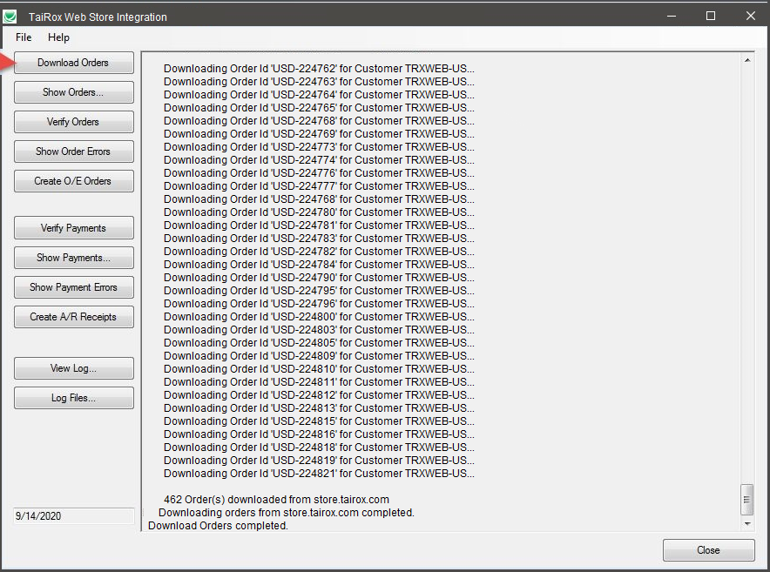
Web Store Integration
80% product
20% customization

Slide 12
Pet Food Distributor
Client sends empty bags to TPM on consignment
The TPM periodically creates a batch of pet food
When a batch is created a number of bags are filled.
When the client takes orders they need to know how many bags are filled.
The TPM needs to know projected future quantities so they can plan batch creation.
Canned goods and POS materials are made elsewhere and sent to the TPM, who is also a 3PL.
The client has 3 Sage 300 Companies
Canadian, USA and TPM-Mirror

Slide 13
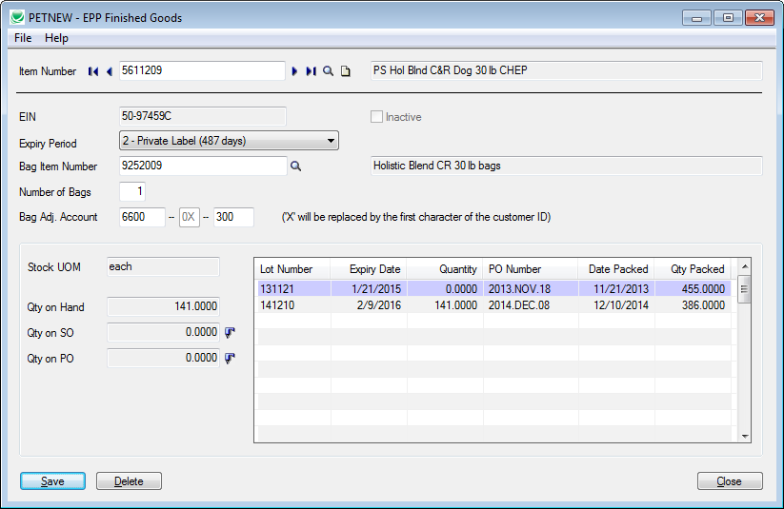
Pet Food Distributor

Slide 14
Solar Street Lamp Distributor
Client has multiple TPMs in China and USA
Street lamp structures are sent to customers
Structures are erected before electronics are installed
Client has multiple 3PLs who ship electronics to customers
Electronics are dependent on GPS location
Sunlight hour variation is different at different latitudes.
Multiple systems update using Microsoft Message Queuing

Slide 15
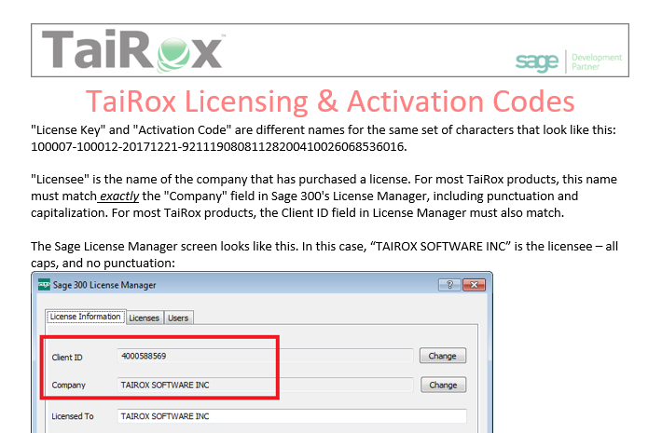
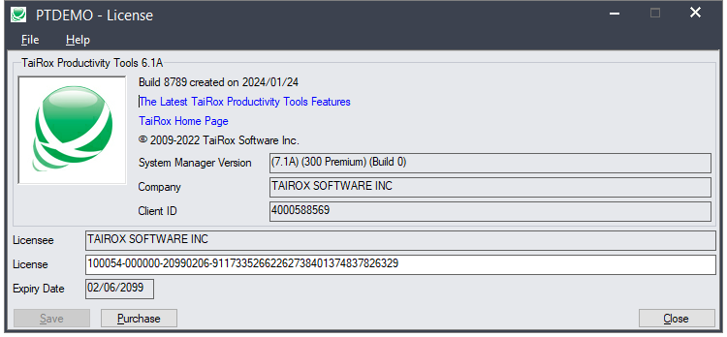
Support: Licensing and Updates

Slide 16
Support: What’s New in Install Check

Slide 17
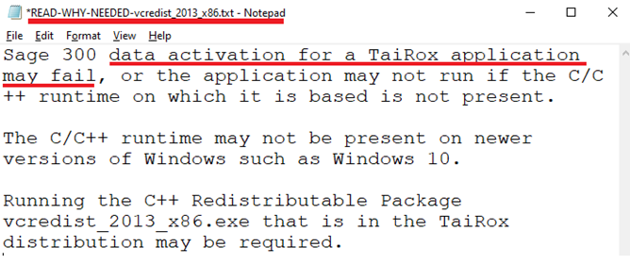
Support: Data Activation, READ-WHY-NEEDED

Slide 18
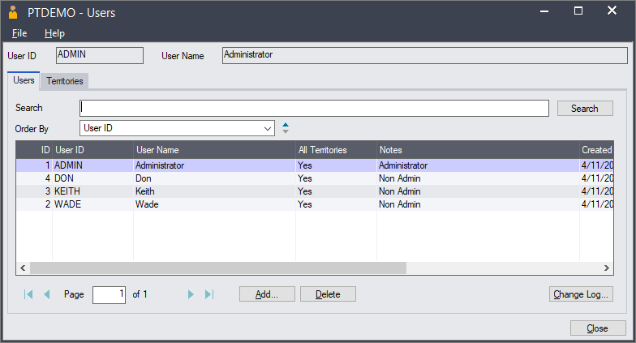
Support: CRM & Collections
ADMIN user sees Collections icons, other users don't see them
You must set up CRM & Collections users!

Slide 19
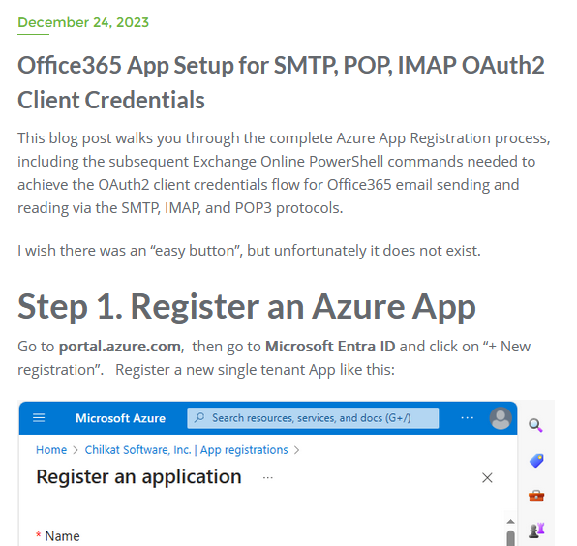
Support: Office 365 Email OAuth2, MS Graph
https://cknotes.com/office365-app-setup-smtp-pop-imap-oauth2-client-credentials/

Slide 20
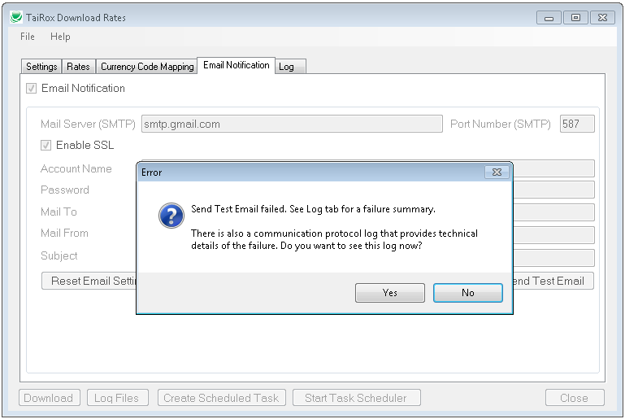
Support: Diagnosing Email Problems

Slide 21
TaiRox Products, What's New

Slide 22
Training Agenda
Integration
Vault and Store Databases (SQL Server Integration)
How Integrations Should Work
Large and Larger - What TaiRox is Seeing More Of
Web Store Integration
TaiRox Support
TaiRox Products: What's New

